Slide 1
UNIT 9
What’s the fastest animal in the world?
Lesson 5

Slide 3
Listen and point

Slide 4
world

Slide 5
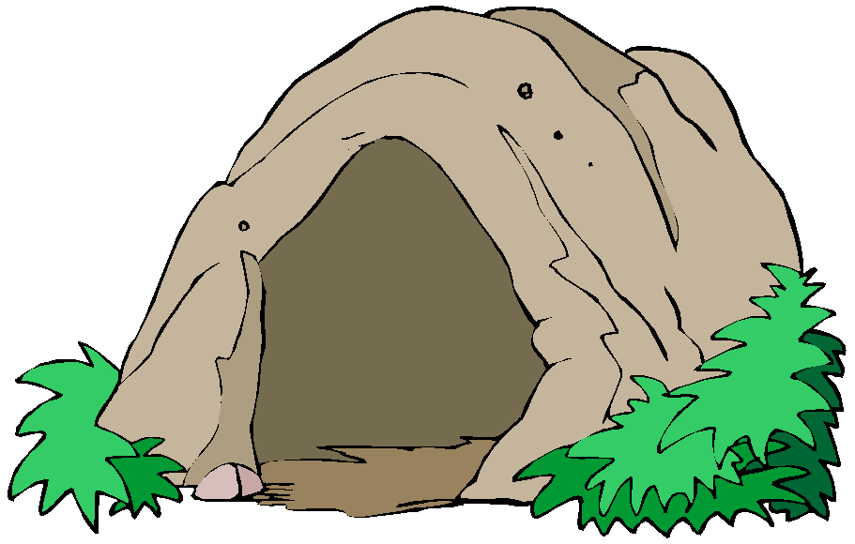
cave

Slide 6
river

Slide 7
building

Slide 8
island

Slide 9
LISTEN and REPEAT

Slide 10
PAIR WORK
POINT AND SAY

Slide 11
Listen and point

Slide 13
READ AGAIN

Slide 15
GAME TIME

Slide 16
Next
Click here to start a game.

Slide 17
TRUE
FALSE
Next
Langbiang is the highest mountain in Vietnam.
Great!

Slide 18
TRUE
FALSE
Next
Son Doong cave doesn’t have any rivers inside it.
Great!

Slide 19
TRUE
FALSE
Next
Son Doong is one of the largest cave in the world.
Great!

Slide 20
Task
Write about your class
. Who is the tallest student?
. Who is the lightest?
. Who is the strongest?
…..

Slide 21
Workbook time!!!

