Slide 1
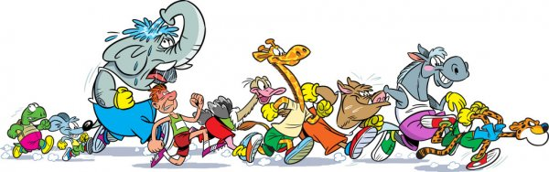
UNIT 9
GRADE 5
What’s the fastest animal in the world?
Lesson 2

Slide 2


Slide 3
Lesson 2:
Listen and point

Slide 4

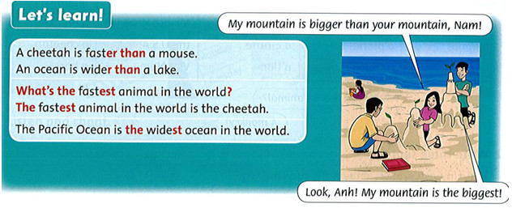

Slide 5
Comparative: so sánh hơn
S1+ tobe+ adj- ER + THAN + S2
Ex: I am shorter than Hoa.
2. Superlative: so sánh nhất
S+ tobe+ THE + adj- EST
Ex: I am the shortest person in my family.

Slide 6
* Note:
good/ well: tốt, giỏi | better than | the best
bad: tệ, dở | worse than | the worst
much/ many: nhiều | more than | the most
little: ít | less than | the least
big: to | bigger than | the biggest

Slide 7
TASK:
3. Read and write T (true) or F (false).

Slide 8
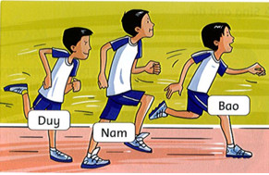
1. Nam is the tallest boy. T
2. Duy is faster than Nam. ___
3. Bao is the fastest boy. ___
4. Nam is slower than Duy. ___
5. Bao is taller than Duy. ___
6. Duy is the shortest boy. ___
F
T
F
T
T

Slide 9
TASK: 4. WRITE

Slide 10
The U.S.A is bigger (big) than Viet Nam.
2. Mount Everest is the ________ (high) mountain in the world.
3. Cars are _______ (fast) than bikes.
4. Grapes are _______ (small) than apples.
5. Lake Baikal is the ________ (deep) lake in the world.
6. Mice are _______ (slow) than cheetahs.
highest
faster
smaller
deepest
slower

Slide 11
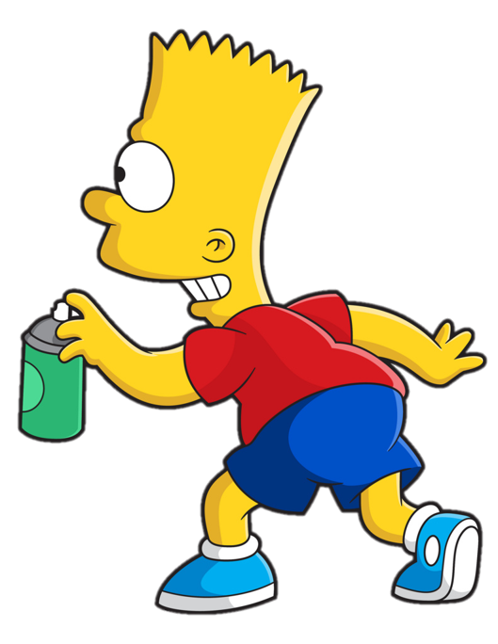

COMPARATIVES

Slide 12
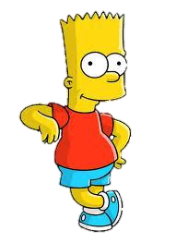



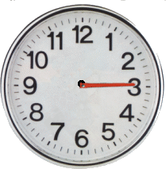





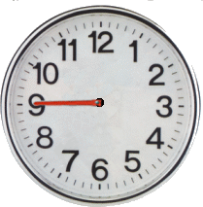


Comparatives or Superlatives
> Bart has deleted some words.
> Guess the deleted adjective within the time limit (12 seconds).

Slide 13


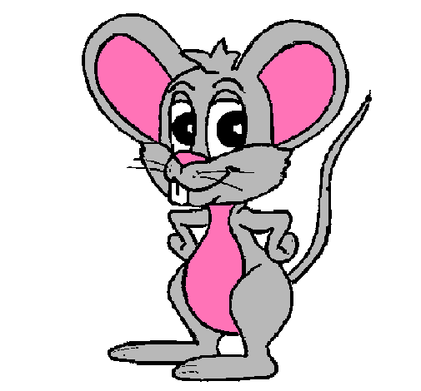
Comparatives
The elephant is bigger than the mouse.
CHECK

Slide 14


Comparatives
The skyscraper is higher than the house.
CHECK
Notes:
14

Slide 15
Comparatives
The worm is shorter than the snake.
CHECK
Notes:
15

Slide 16
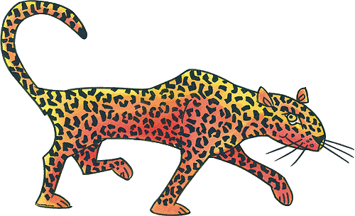

Comparatives
The cheetah is faster than the turtle.
CHECK
Notes:
16

Slide 17
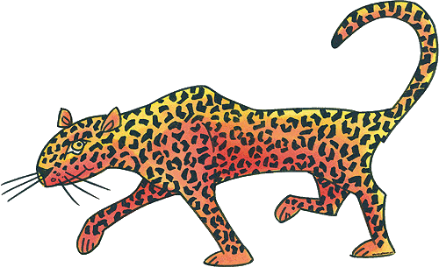

Comparatives
The turtle is slower than the cheetah.
CHECK
Notes:
17

Slide 18

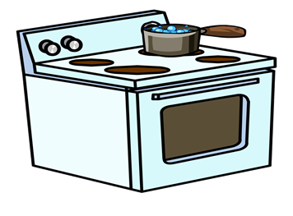
Superlatives
The volcano is the hottest .
CHECK
Notes:
18

Slide 19
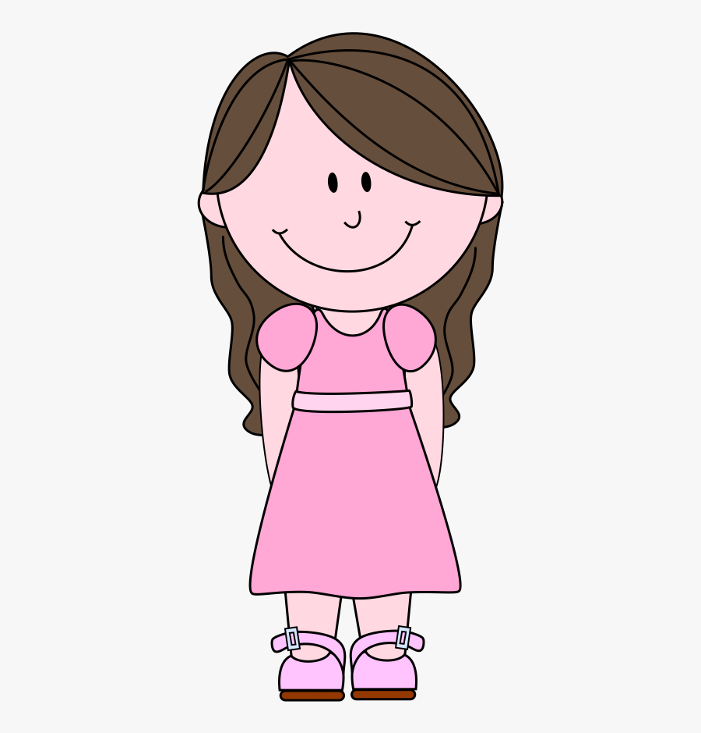
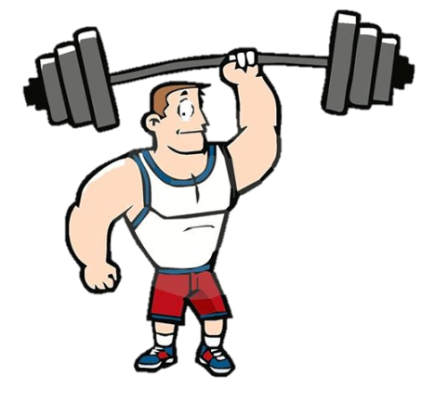

Superlatives
The boy is the weakest.
CHECK
Notes:
19

Slide 20
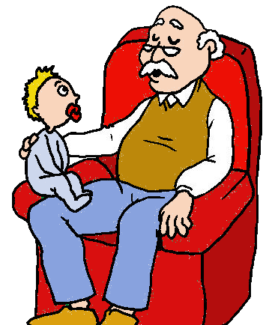
Comparatives
The man is older than the baby.
CHECK
Notes:
20

Slide 21

Workbook time!!!

