Slide 1
Grade 3 Unit 8 WHERE’S GRANDMA?
LESSON 4

Slide 3
Game time

Slide 4
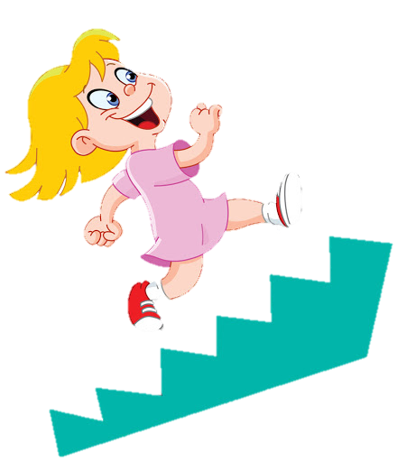
u
p
s
t
a
i
r
s
Q
W
E
R
T
Y
U
I
O
P
A
S
D
F
G
H
J
K
L
Z
X
C
V
B
N
M

Slide 5
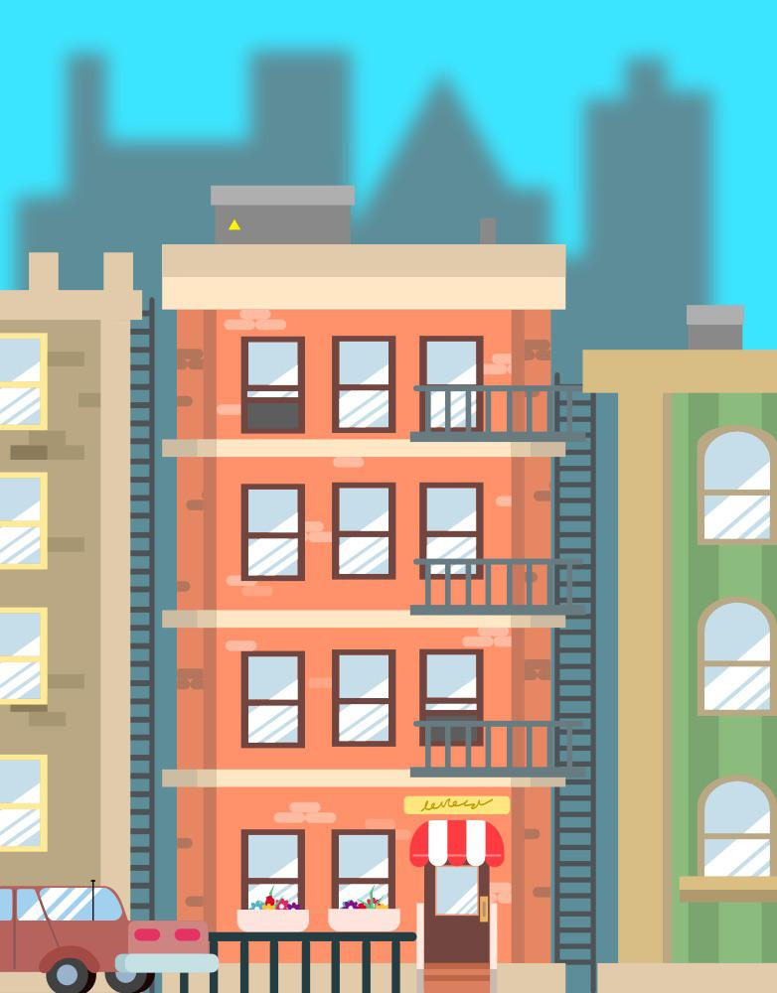
a
p
a
r
t
m
e
n
t
Q
W
E
R
T
Y
U
I
O
P
A
S
D
F
G
H
J
K
L
Z
X
C
V
B
N
M

Slide 6
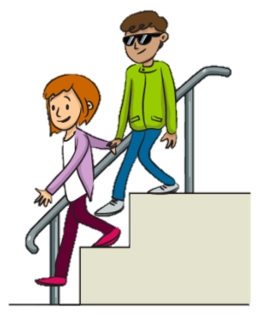
d
o
w
n
s
t
a
i
r
s
Q
W
E
R
T
Y
U
I
O
P
A
S
D
F
G
H
J
K
L
Z
X
C
V
B
N
M

Slide 7
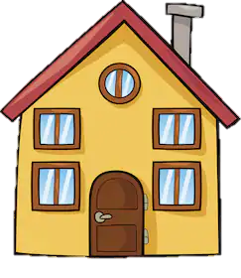
h
o
u
s
e
Q
W
E
R
T
Y
U
I
O
P
A
S
D
F
G
H
J
K
L
Z
X
C
V
B
N
M

Slide 8
Monday, February 14th, 2022
Unit 8: Where’s grandma?
* Lesson 4:

Slide 10
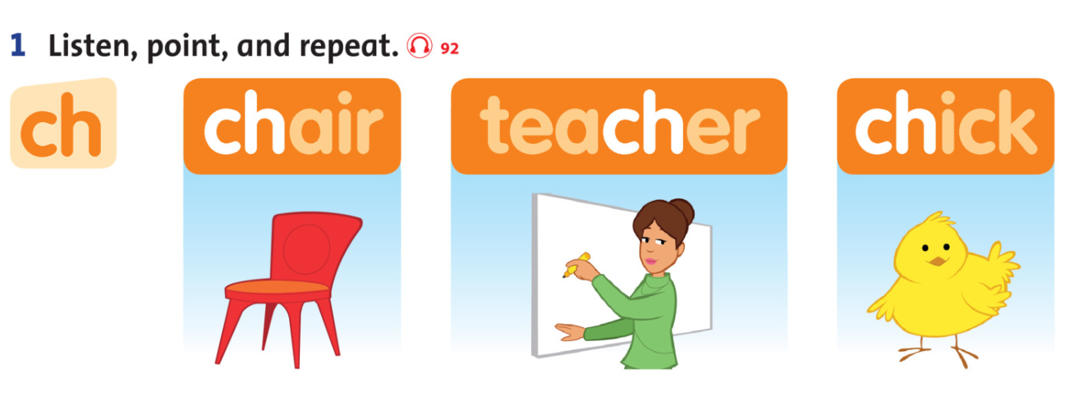

Slide 12
TASK: Read the chant again. Circle the ch sound.

Slide 14
LET’S CHANT

Slide 16
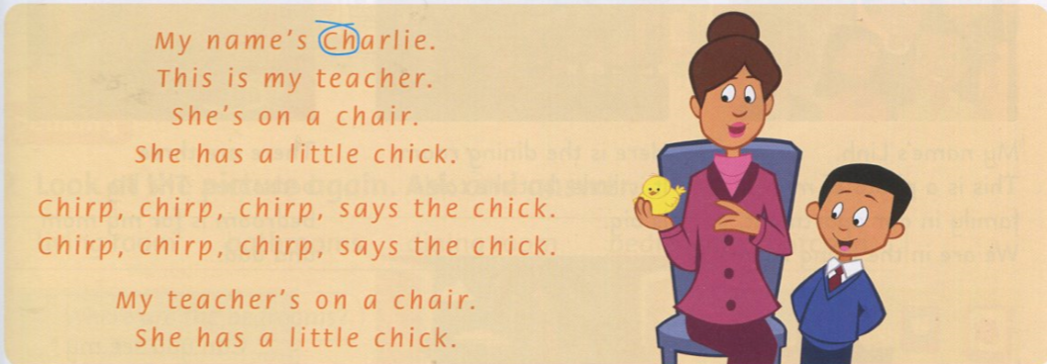
GROUP WORK: Chant and do

Slide 17
TASK: Look at the picture and circle the correct sound.

Slide 19
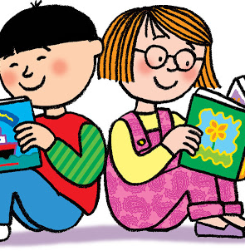
Workbook time
This Photo by Unknown Author is licensed under CC BY-NC-ND

Slide 20
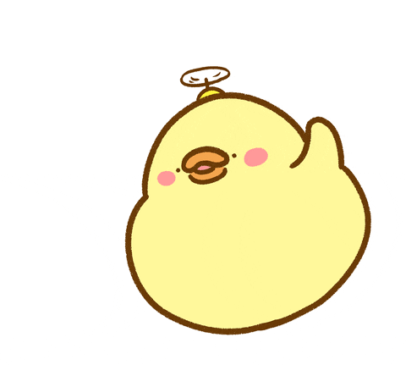
It’s time to say GOODBYE

