Slide 1
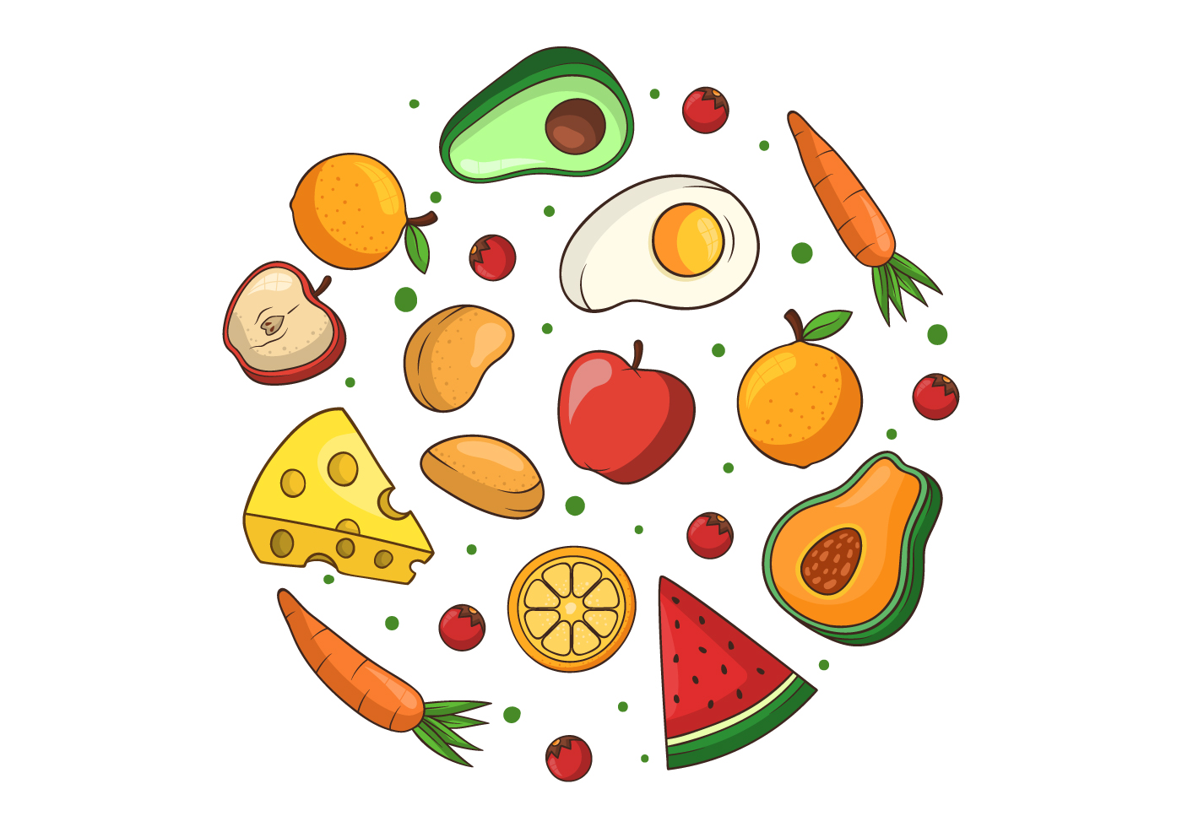
GRADE 5
UNIT 8
I’d like a melon.
Lesson 2

Slide 3
Listen and point

Slide 5
LISTEN and REPEAT

Slide 7
Countable noun: danh từ đếm được | Uncountable noun: danh từ không đếm được
Số ít: dùng a/ an / one Ex: a banana an orange | Không có số ít, số nhiều. Không thêm s/es. Chỉ dùng some Ex: some bread, some rice
2. Số nhiều: dùng số đếm / some và thêm s/es Ex: two bananas Some bananas
Ex: | Ex:

Slide 8
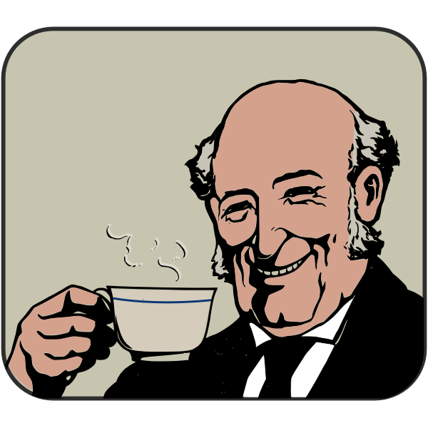
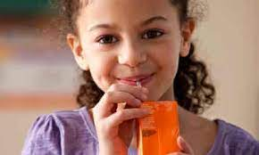
Practice: Would like = ‘d like: mong muốn (mang tính lịch sự)
I’d like some coffee.
He’d like some tea.
She’d like some juice.

Slide 10
LET’S PLAY!

Slide 11
DAISY
GRAMMAR
START

Slide 12
egg
omelet
sausage
avocado
apple
an
oil
orange
banana
onion
apricot
eggplant
olive

Slide 13
potato
pineapple
egg
pear
kiwi
a
tomato
lime
melon
mango
apple
pea
pancake

Slide 14
meat
sugar
apple
salt
noodles
some
banana
soup
lemon
tea
honey
butter
cereal

Slide 15
Choose 'a, an, or some’.
Write the words in the correct boxes.
apple / salad / bread / cookie / egg / rice / melon / juice / water / orange.
COUNTABLE | UNCOUNTABLE
an apple | Some salad
a cookie
Some bread
an egg
Some rice
Some juice
a melon
Some water
an orange

Slide 16
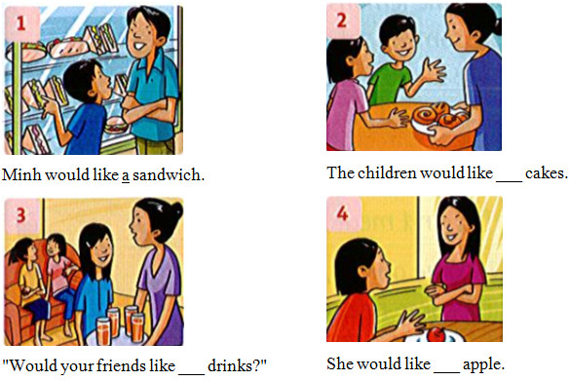
Write
a / an / some
some
some
an

Slide 17
Workbook time!!!

