Slide 1
Grade 3 Unit 8 WHERE’S GRANDMA?
LESSON 1

Slide 6
Game time

Slide 7
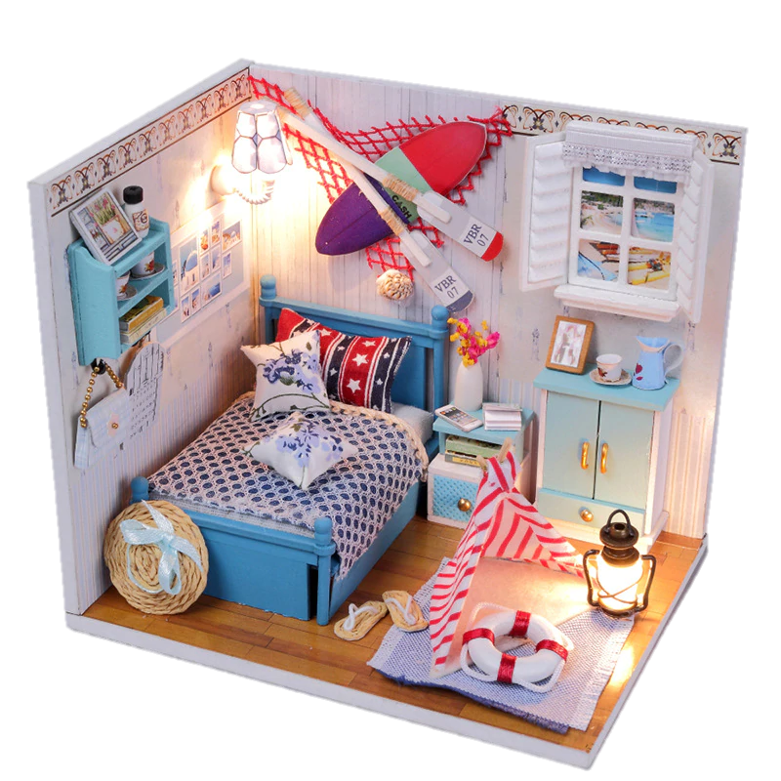
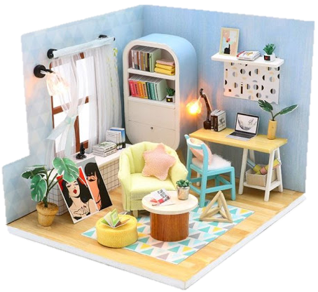
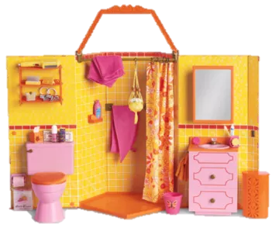
living room

Slide 8
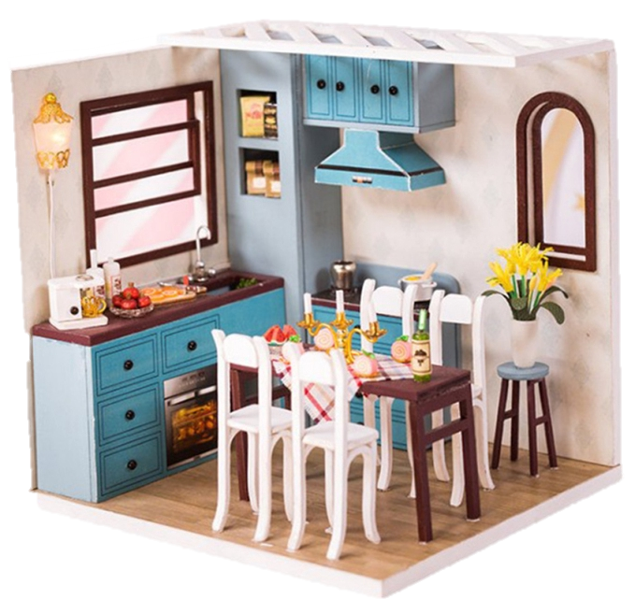
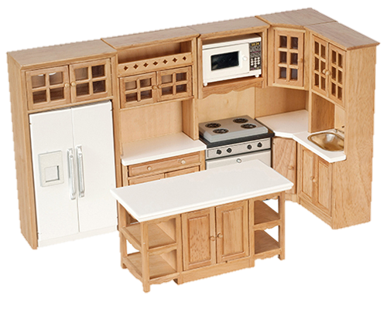
kitchen

Slide 9
bedroom

Slide 10
dining room

Slide 11
bathroom

Slide 12
PAIRWORK: ANSWER THESE QUESTIONS
1. WHERE ARE THEY?
2. HOW MANY PEOPLE ARE THERE?

Slide 14
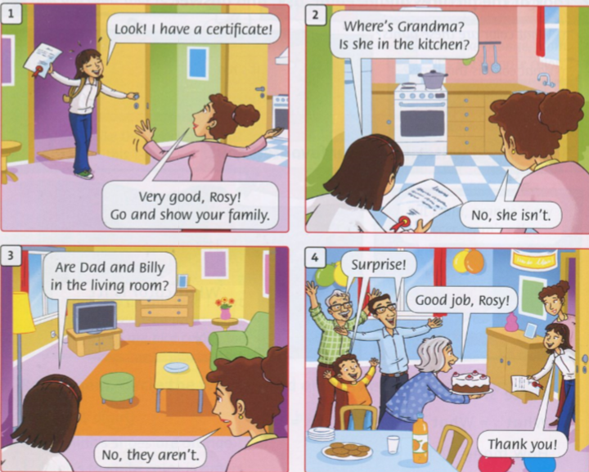
GROUP WORK: Play the roles

Slide 15
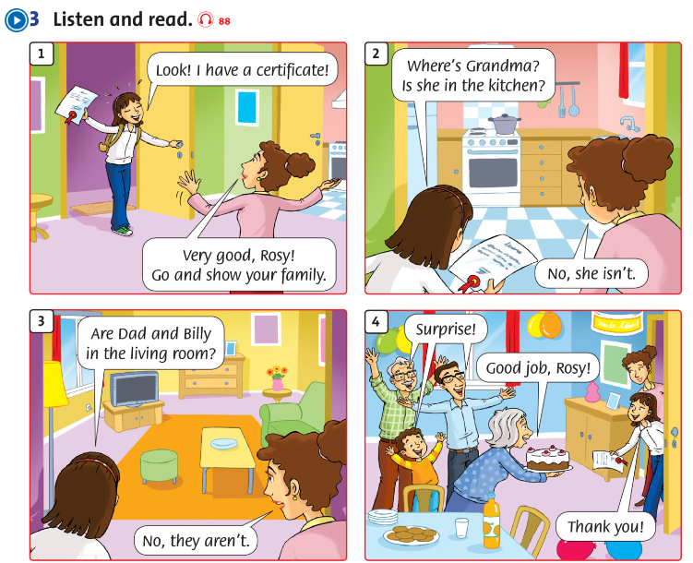

Slide 16
Workbook p.54
This Photo by Unknown Author is licensed under CC BY-NC-ND

Slide 17
It’s time to say GOODBYE

