Slide 1
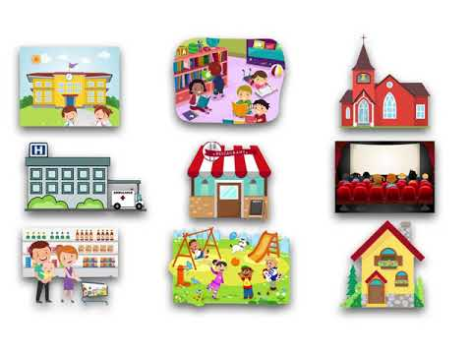
GRADE 5
UNIT 7
Places to go
Lesson 5

Slide 2
Listen and point

Slide 3

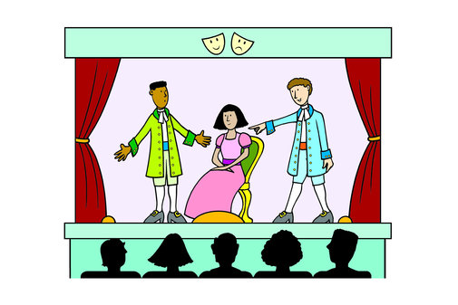
play

Slide 4

concert

Slide 5
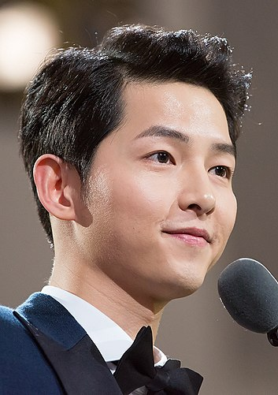
actor

Slide 6

movie

Slide 7

singer

Slide 8

LISTEN and REPEAT

Slide 9
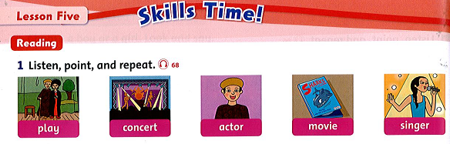

Slide 10
Listen and point

Slide 11


Slide 12
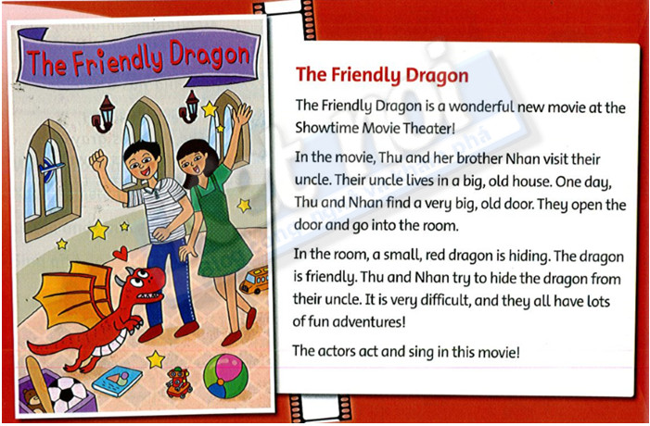

Slide 13
Let’s play!!!

Slide 14

YES or NO
START

Slide 15


YES
NO
Do Thu and Nhan visit their grandparents?

Slide 16

YES
NO
Do Thu and Nhan find a big door?

Slide 17
YES
Is the dragon in the park?
NO

Slide 18
YES
NO
Is the dragon friendly?

Slide 19
YES
NO
Do Thu and Nhan try to hide the dragon from their mom?

Slide 20
YES
NO
Do the actors sing in the story?

Slide 21
Read again and answer the questions.
Do Thu and Nhan visit their grandpa? No 3. Is the dragon in a garden? ___ 5. Is the movie sad? ___ | 2. Do they find a door? ___ 4. Do they try to hide the dragon? ___ 6. Do the actors sing in the movie? ___
Yes
Yes
No
Yes
No

Slide 22

Workbook time!!!

Slide 23
Thursday, March 3rd, 2022
Unit 7: Places to go
* Lesson 5:
play: vở kịch
concert: buổi hòa nhạc
actor: diễn viên nam
movie (film): phim
singer: ca sĩ
dragon: rồng
adventure: cuộc phiêu lưu
hide: trốn, ẩn nấp, giấu

