Slide 1
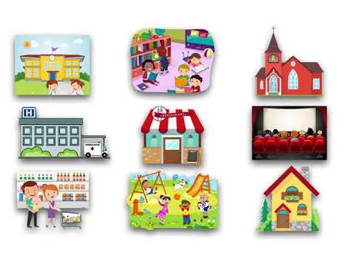
GRADE 5
UNIT 7
Places to go
Lesson 1

Slide 2
Listen and point

Slide 3
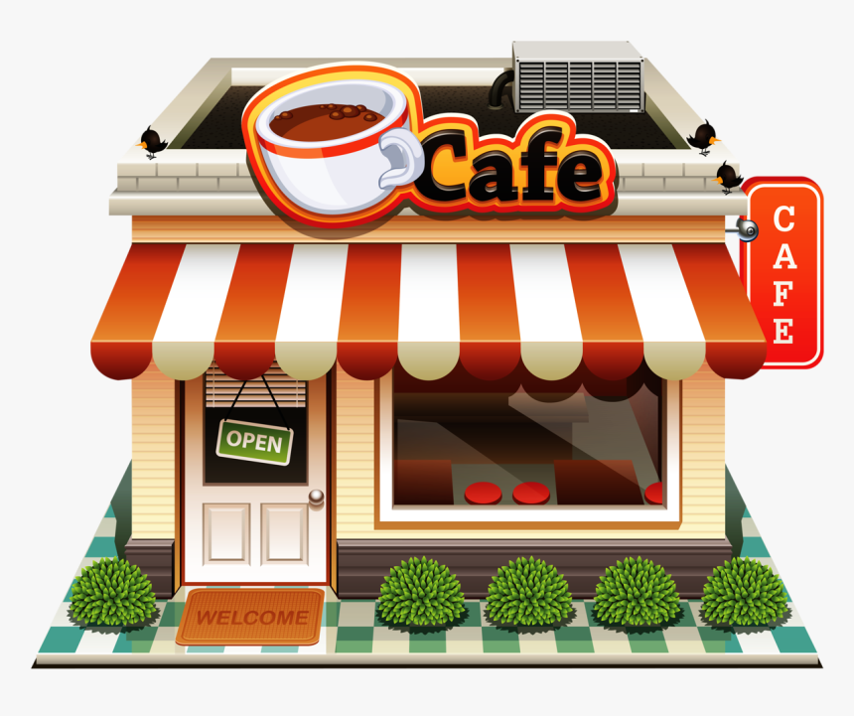
cafe

Slide 4
library

Slide 5
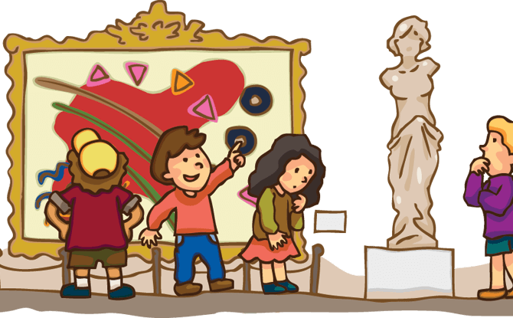
museum

Slide 6
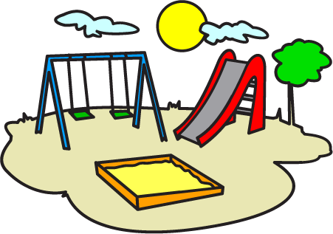
playground

Slide 7
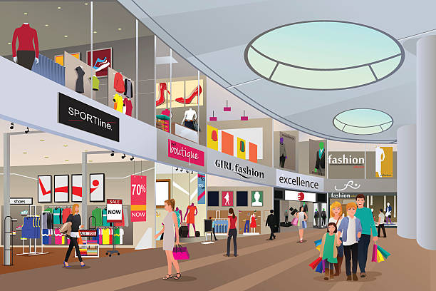
shopping mall

Slide 8
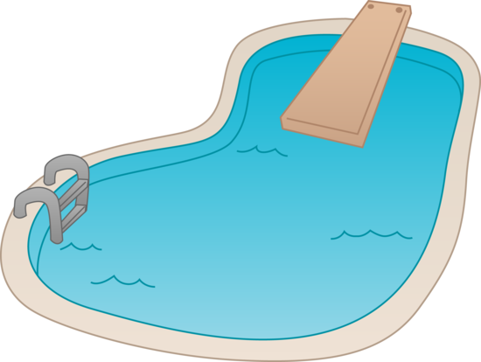
swimming pool

Slide 9
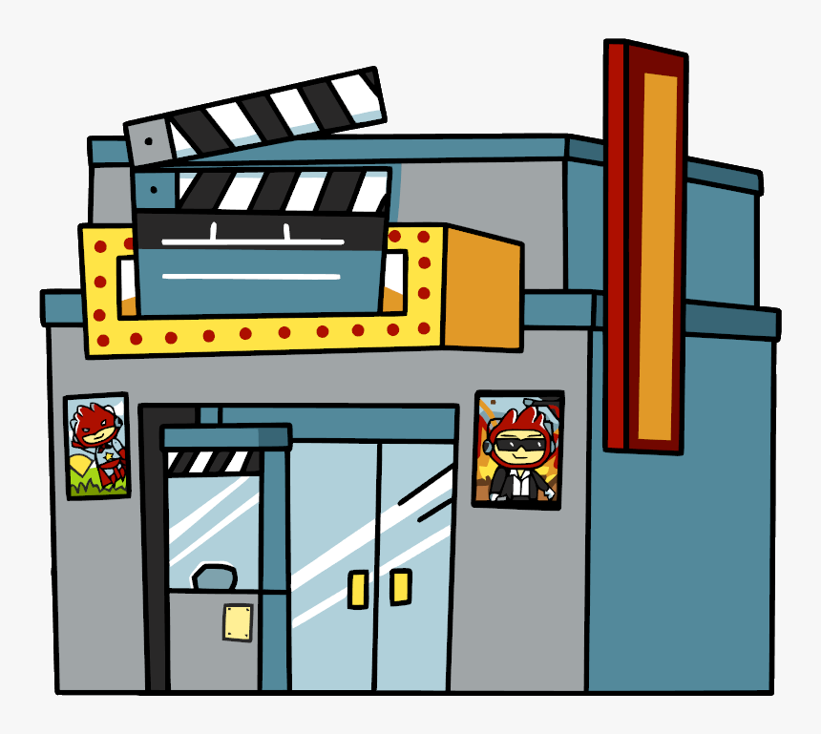
movie theater

Slide 10
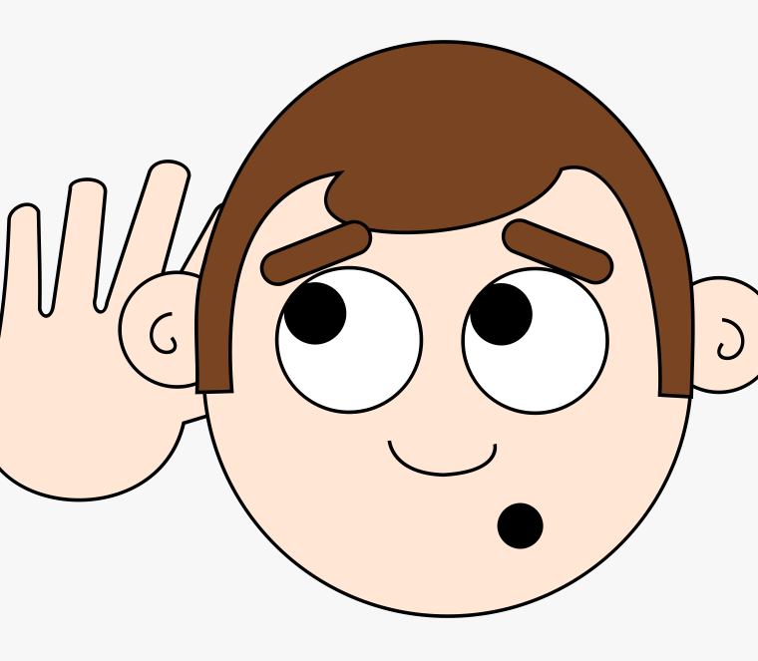
LISTEN and REPEAT

Slide 11
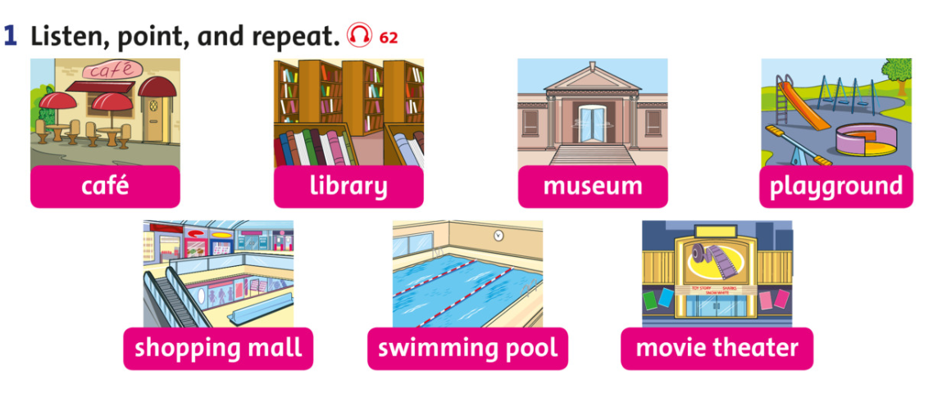

Slide 12
WORD DUCKS
START

Slide 13
I want to drink coffee.
museum
school
café

Slide 14
I want to see a film.
movie theater
shopping mall
museum

Slide 15
I want to see old things.
café
museum
playground

Slide 16
I want to play with my friends.
museum
movie theater
playground

Slide 17
I want to buy things.
hospital
library
shopping mall

Slide 18
I want to read a book.
library
cinema
market

Slide 19
I want to swim.
shopping mall
swimming pool
café

Slide 20
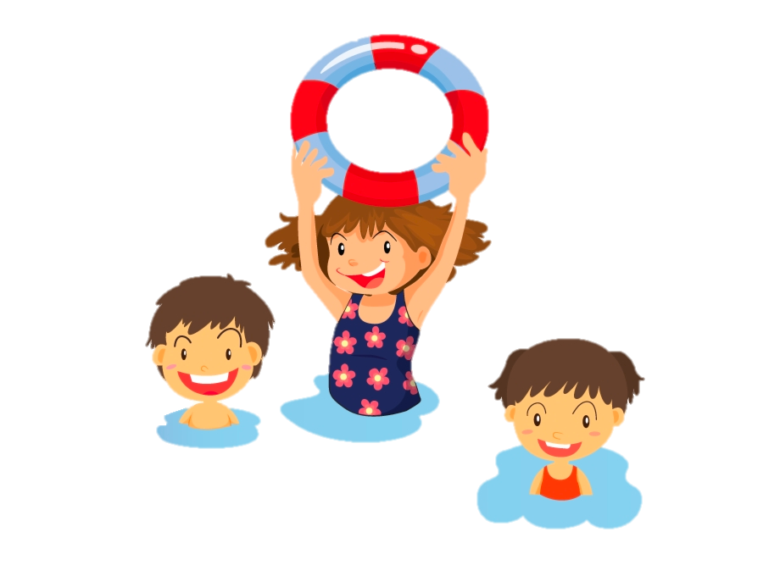
Well done!

Slide 21
Tasks: Watch the video and answer these questions
Where are they?
What are they doing?

Slide 23
Pair work: answer these questions
Where are they?
What are they doing?

Slide 24
GROUPWORK: Role play

Slide 25
Workbook time!!!

