Slide 1

Welcome to our class!
Teacher’s : Nguyen Thi Hong Thu
Class: 3A

Slide 2

Thursday, December 21st , 2021
Unit 6: Billy’s teddy bear?
Lesson 4&5

Slide 3
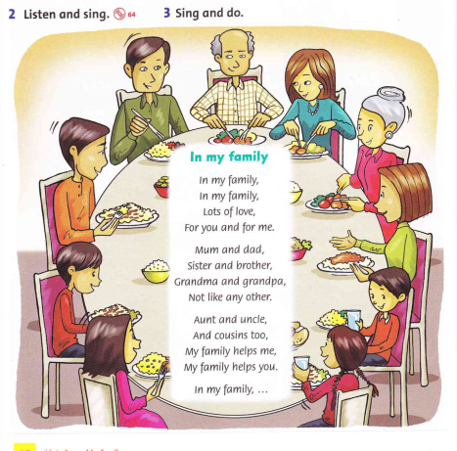


Slide 4
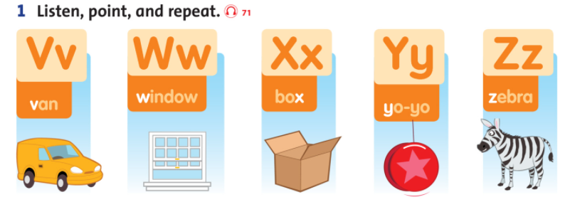

Slide 5
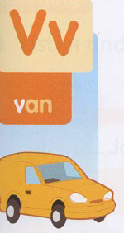

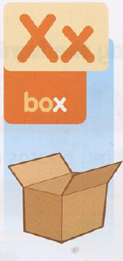

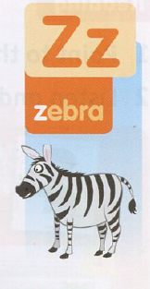

Slide 6
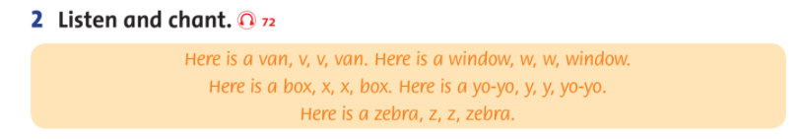

Slide 7
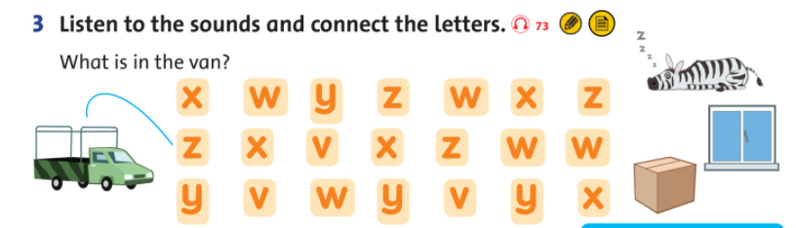

Slide 8


Slide 9
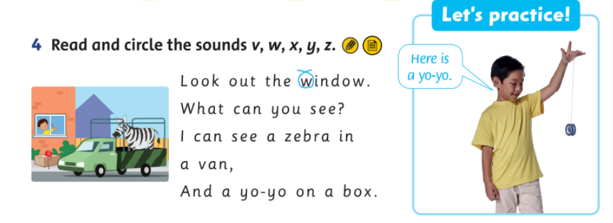

Slide 10
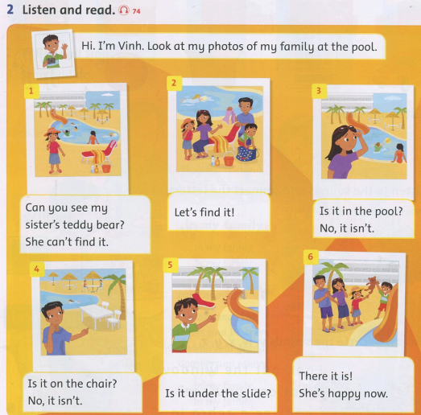

Slide 11
Read again. Write T(true) or F (False).

Slide 12


It is Vinh’s teddy bear.
A. F
B. T

Slide 13
The teddy bear is in the pool.
A. T
B. F

Slide 14
Vinh’s sister is happy now.
A. F
B. T

Slide 15

The students to do exercise in workbook
pages 44+ 45.

Slide 16


Goodbye~!

