Slide 1
Game time
Notes:
LISTEN AND CHOOSE
CLICK THE SPEAKER
CHOOSE THE CORRECT PICTURE
CLICK THE GREEN ICON TO MVE TO THE NEXT ONE

Slide 2
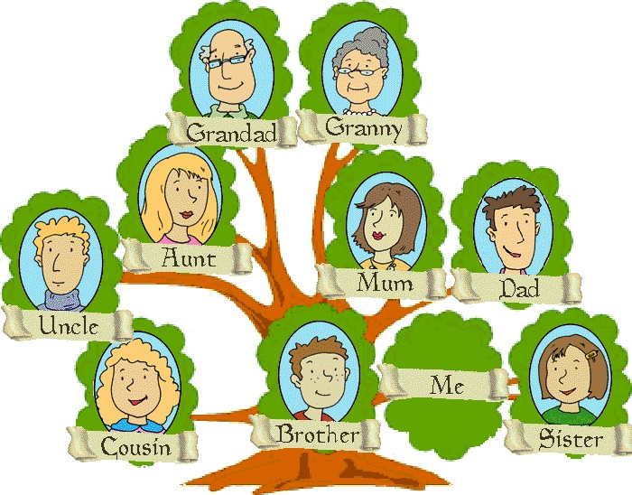
Grandpa
Grandma
Aunt
Mom
Dad
Uncle
Me
Brother
Sister
Cousin

Slide 3
Grandpa
Grandma
Aunt
Mom
Dad
Uncle
Me
Brother
Sister
Cousin

Slide 4
Grandpa
Grandma
Aunt
Mom
Dad
Uncle
Me
Brother
Sister
Cousin

Slide 5
Grandpa
Grandma
Aunt
Mom
Dad
Uncle
Me
Brother
Sister
Cousin

Slide 6
Grandpa
Grandma
Aunt
Mom
Dad
Uncle
Me
Brother
Sister
Cousin

Slide 7
Grandpa
Grandma
Aunt
Mom
Dad
Uncle
Me
Brother
Sister
Cousin

Slide 8
Grandpa
Grandma
Aunt
Mom
Dad
Uncle
Me
Brother
Sister
Cousin

Slide 9
Unit 6: Billy’s teddy bear
Grade 3
LESSON 4

Slide 10
LISTEN AND POINT

Slide 12
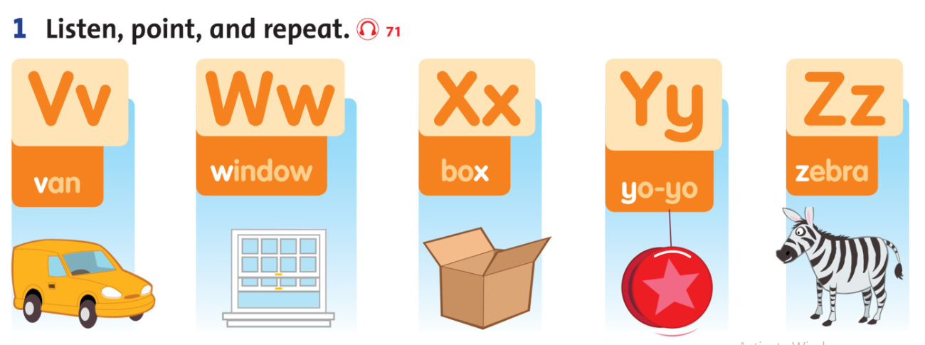

Slide 13
Listen to the sounds and connect the letters.

Slide 14
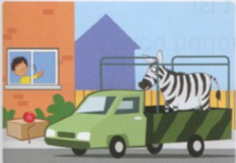
Read and circle the sounds V, W, X, Y, Z at the start of the words.
Look out the window.
What can you see?
I can see a zebra in a van,
And a yo-yo on a box.

Slide 15
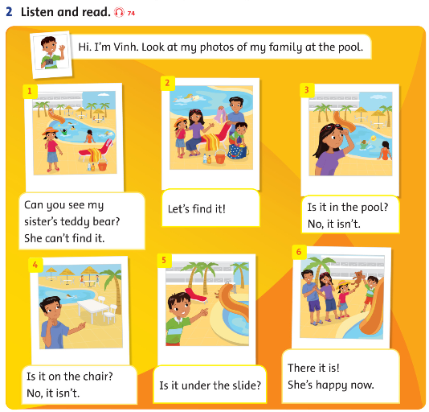
Lesson 5
can: có thể
can’t: không thể
find: tìm
happy: vui

Slide 16
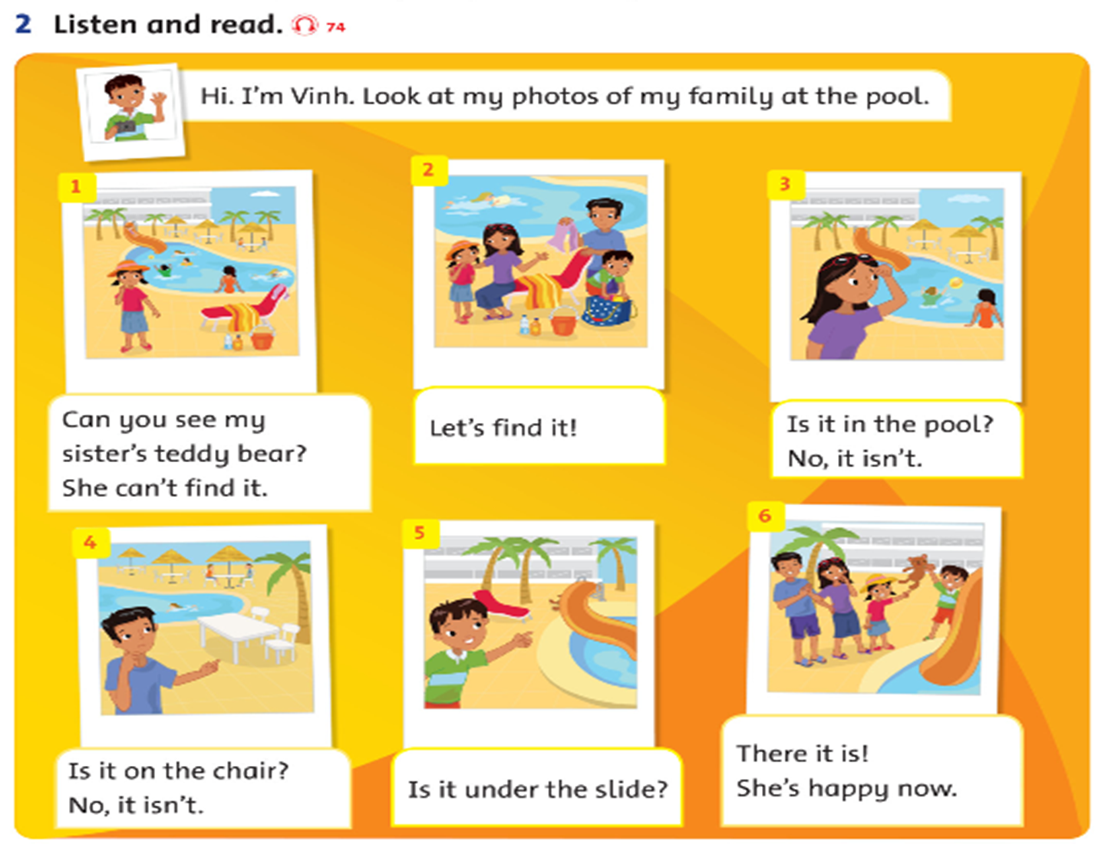
F
F
T

Slide 17
Workbook time
This Photo by Unknown Author is licensed under CC BY-NC-ND

Slide 18
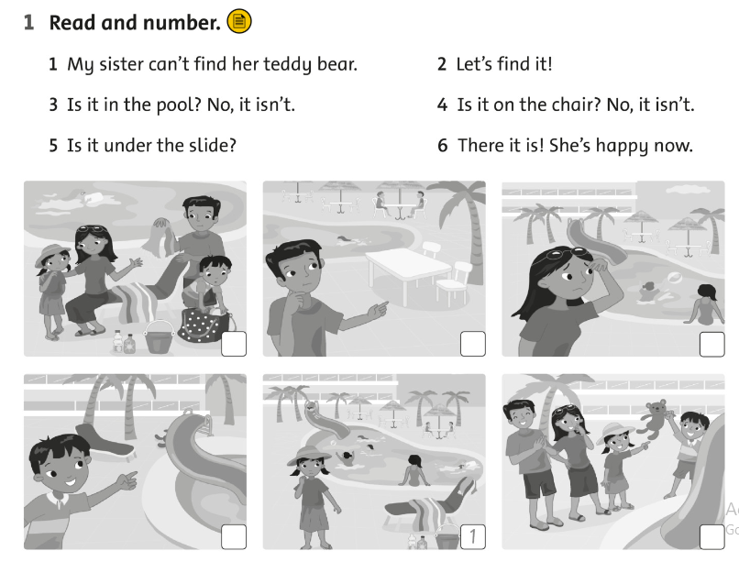
2
4
3
5
6

Slide 19
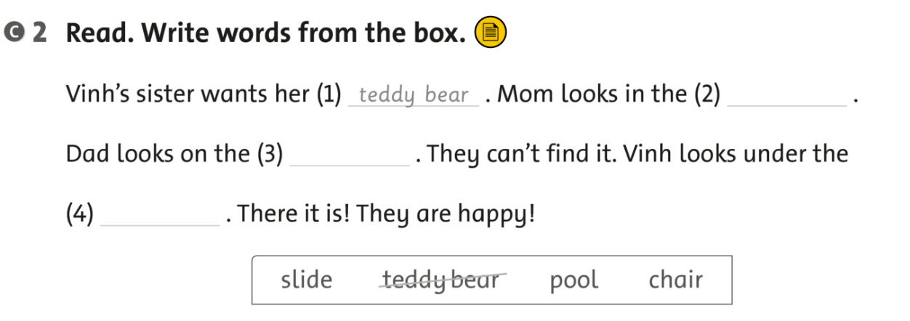
pool
chair
slide

Slide 20
Wednesday, December 29th, 2021
Unit 6: Billy’s teddy bear
Lesson 4:
V v: van: xe tải nhỏ
W w: window: cửa sổ
X x: box: cái hộp
Y y: yo – yo
Z z: zebra: ngựa vằn

Slide 21
It’s time to say GOODBYE

