Slide 1
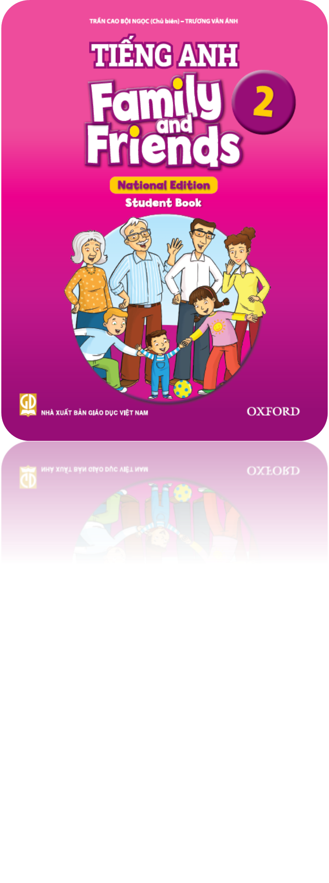
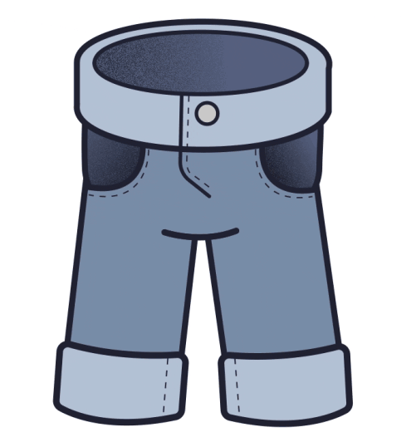
Grade 2
Unit 3
Are these his pants?
Lesson 5

Slide 2
Review

Slide 3
A. Sixteen
B. Fourteen
C. Fourteen

Slide 4
A. Thirteen
B. Fiveteen
C. Fifteen

Slide 5
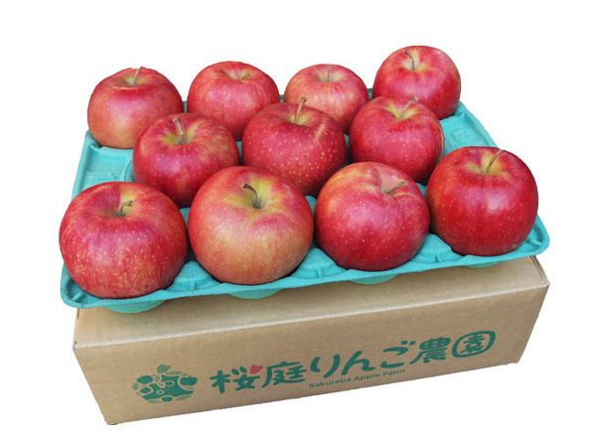
A. ten
B. eleven
C. thirteen

Slide 6
Monday, December 27th ,2021
Unit 3: Are these his pants?- lesson 5

Slide 7
1.Listen,point and repeat

Slide 9
Vv
Violin: đàn vĩ cầm
Vase: bình (cắm hoa)

Slide 10
2.Listen the chant.

Slide 12
Listen and chant

Slide 14
Connect

Slide 16
Consolidation!

Slide 17
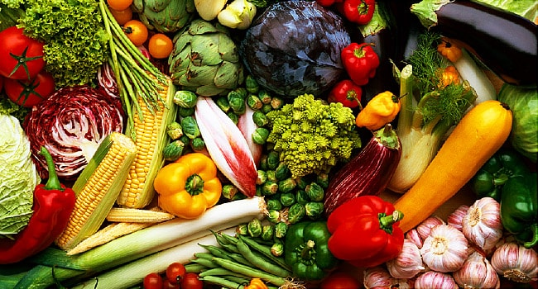
vegetable

Slide 18
talk

Slide 19
umbrella

Slide 20
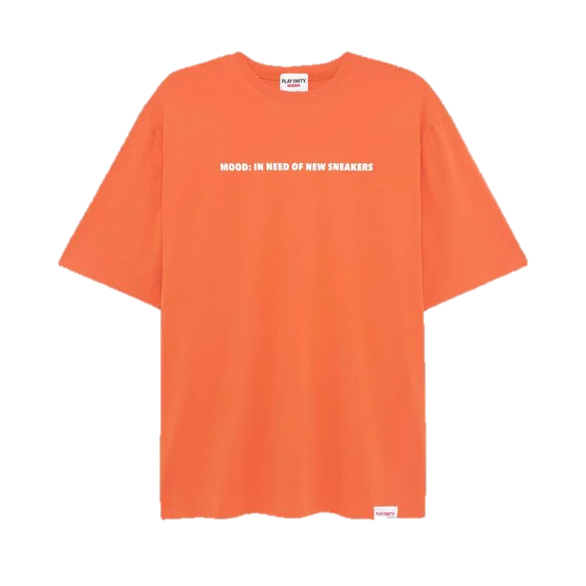
T-shirt

Slide 21
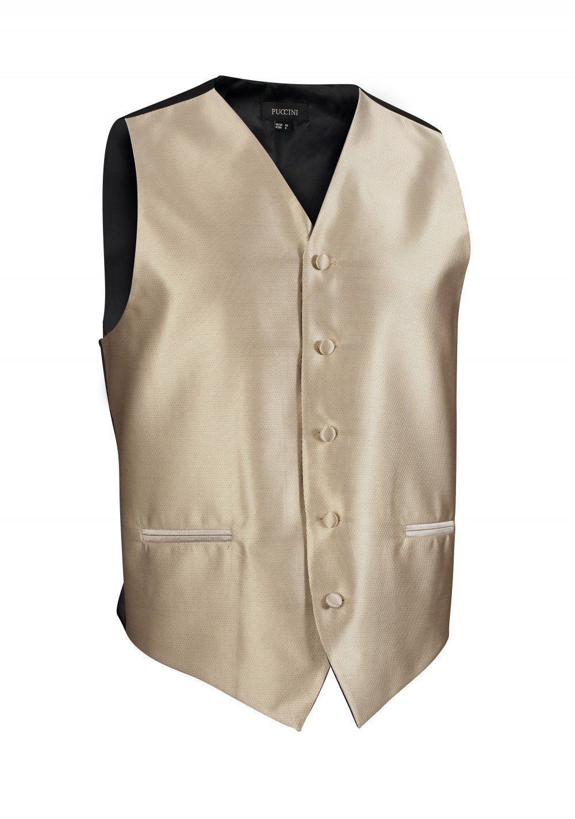
vest

Slide 22
understand

