Slide 1
Unit 12 Look at the photos!
LESSON 1
GRADE 4

Slide 2
Hello everyone!

Slide 3
NEW WORDS

Slide 5
Listen and repeat

Slide 6
LISTEN AND CHANT

Slide 7
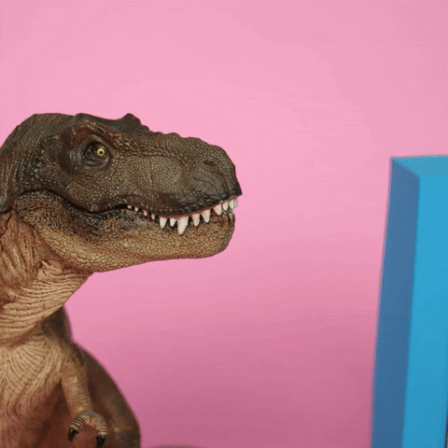
It’s time for a game!

Slide 8
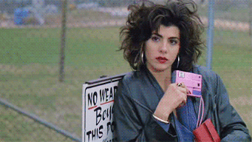
good
dry
wet
photo
bad

Slide 9
good
dry
wet
bad

Slide 10
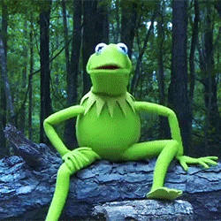
dry
wet
bad

Slide 11
dry
bad

Slide 12
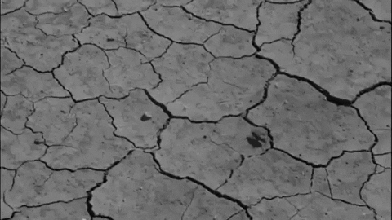
dry

Slide 13
Story

Slide 15
Tasks: Work in groups
Role play with your groups!

Slide 16
Tasks: Worktime!
Finish the works in your workbook!

Slide 17
Goodbye~!

