Slide 1
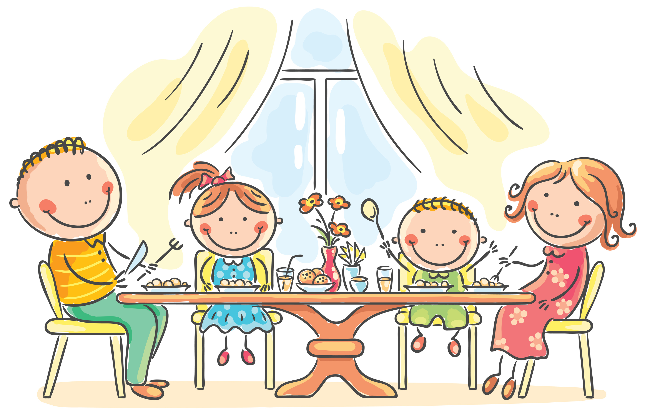
Grade 3
Unit 12
Dinner time
Lesson 2

Slide 2
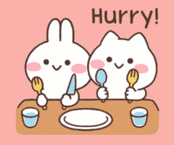
HELLO!

Slide 3

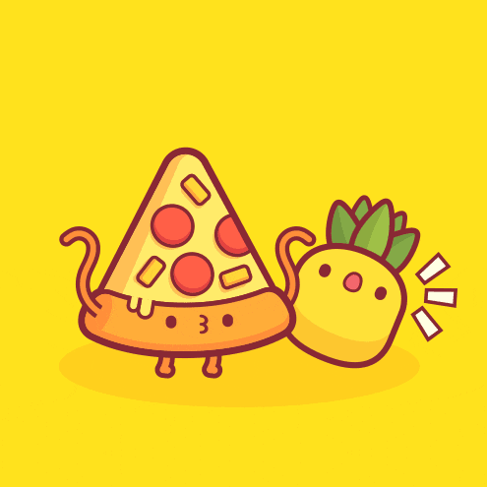

Game time

Slide 4
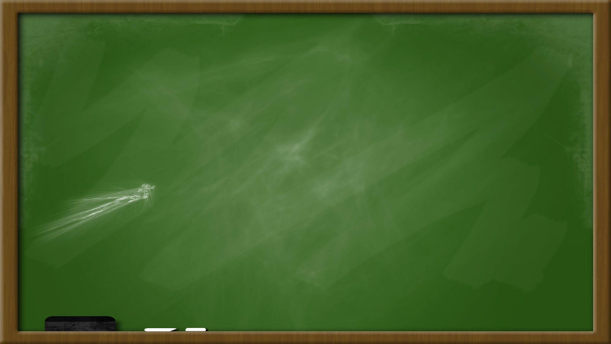
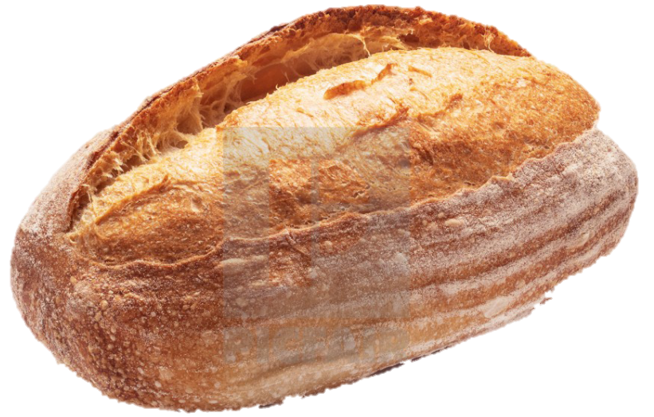
s
t
e
y
d
r
c
a
u
h
b
j

Slide 5
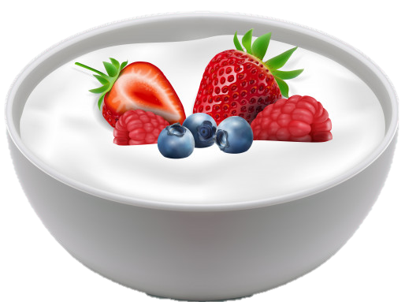
g
t
m
y
t
r
k
i
u
s
o
j

Slide 6
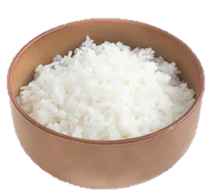
w
u
e
v
d
r
c
a
t
m
l
i

Slide 7
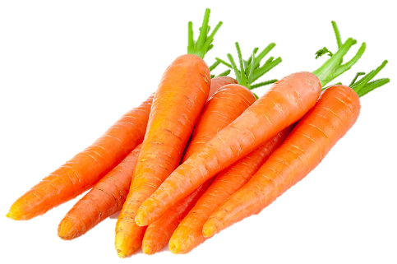
c
t
s
y
m
r
r
i
k
q
o
a

Slide 8
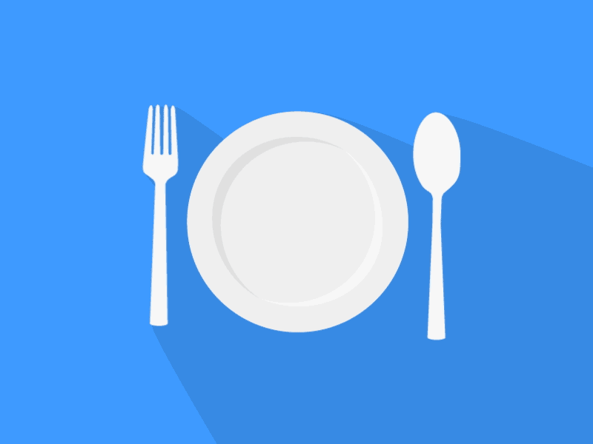
LET’S CHANT!

Slide 9
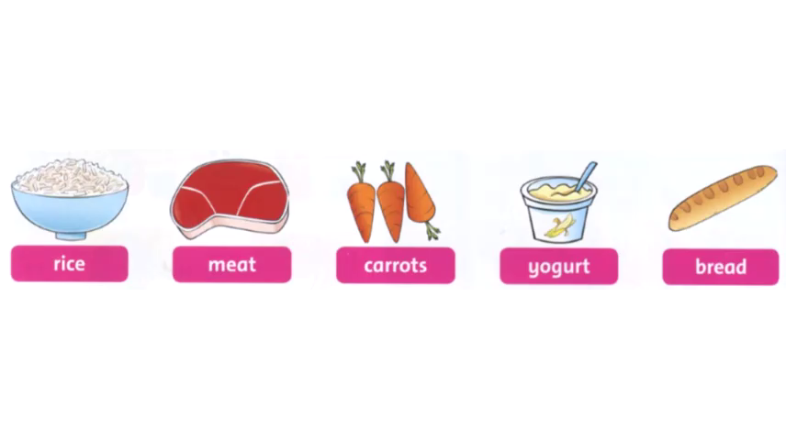

Slide 10
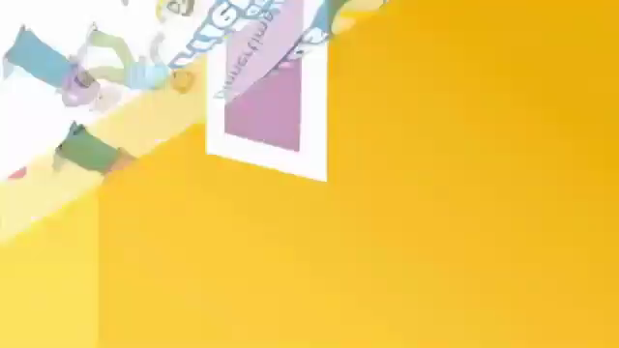

Slide 11

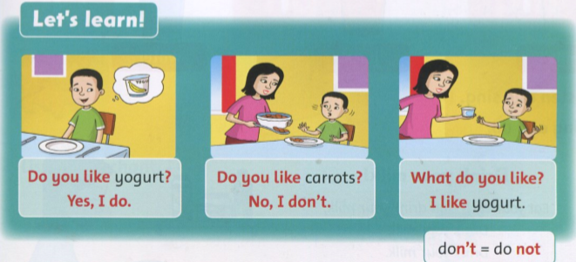

Slide 12
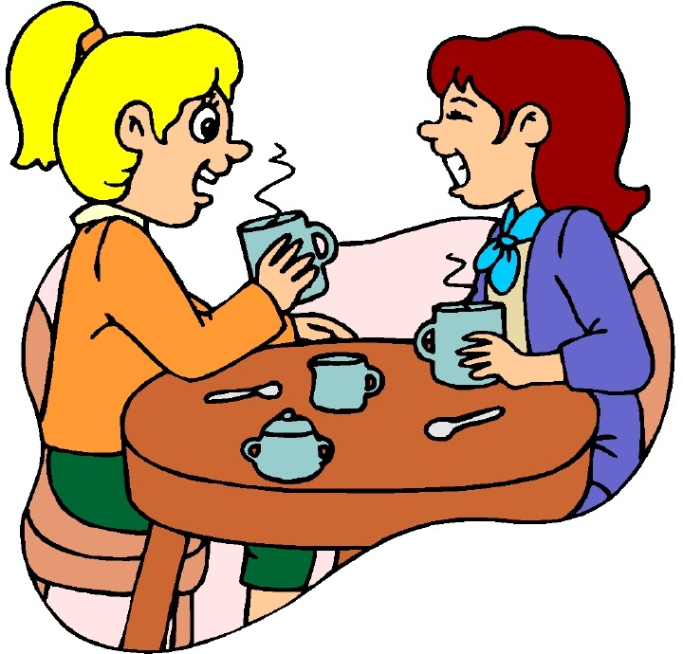
Practice:
Do you like pizza ?
Yes, I do.

Slide 13
Practice:
Note: do not = don’t
Do you like meat ?
No, I don’t.

Slide 14
Practice:
What do you like ?
I like ………

Slide 15
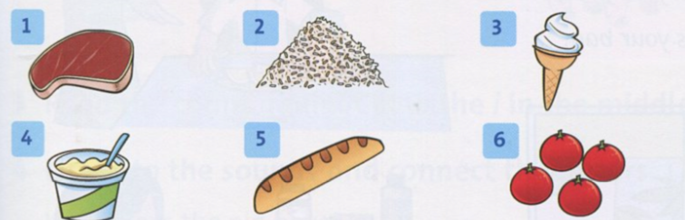
Look and say. meat / rice / ice cream / yogurt / bread / tomatoes.
Example:
Do you like meat?
=> Yes, I do.

Slide 16

TASK:
WRITE

Slide 17
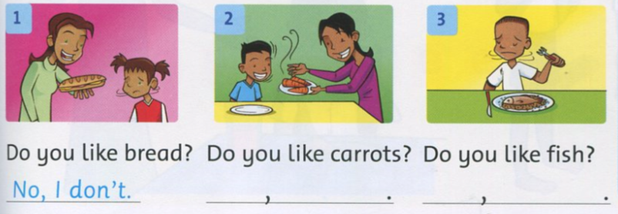
Yes, I do.
No, I don’t.

Slide 18
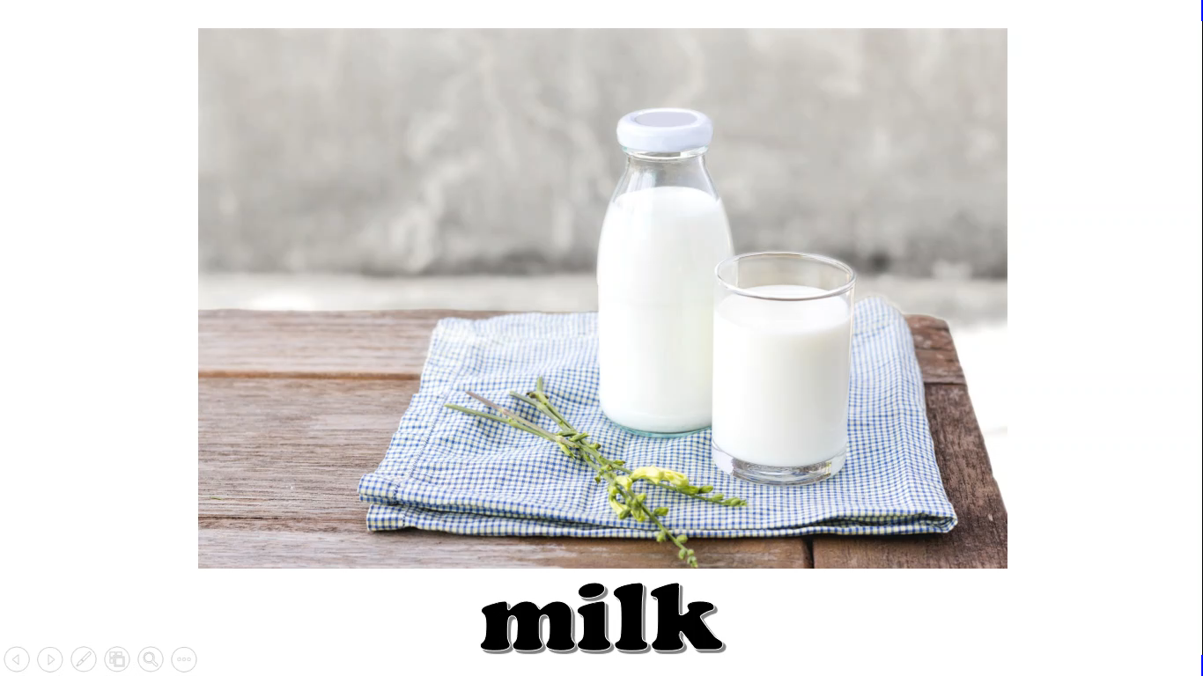

Slide 19
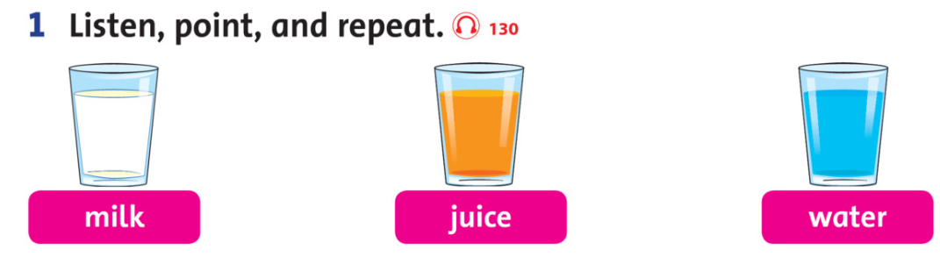

Slide 20
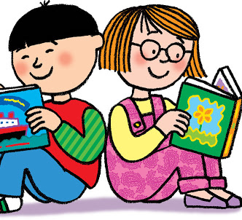
Workbook time
This Photo by Unknown Author is licensed under CC BY-NC-ND

Slide 21
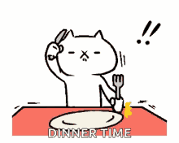
BYE BYE!

