Slide 1
UNIT 10
GRADE 5
In the park

Slide 2
Listen and point
Lesson 1

Slide 3
path

Slide 4
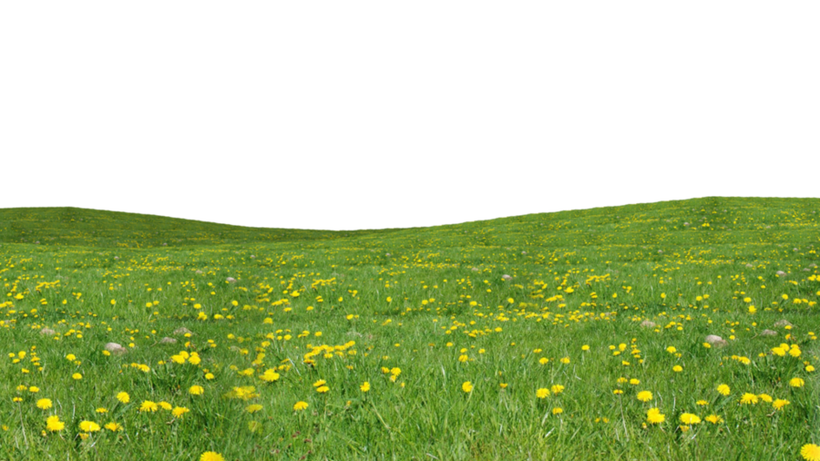
grass

Slide 5
flowers

Slide 6
garbage can

Slide 7
trees

Slide 8
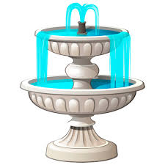
fountain

Slide 9
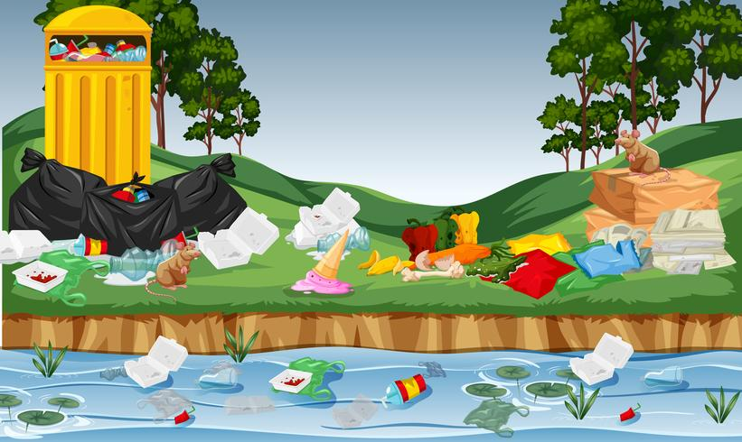
litter

Slide 10
LISTEN and REPEAT

Slide 11
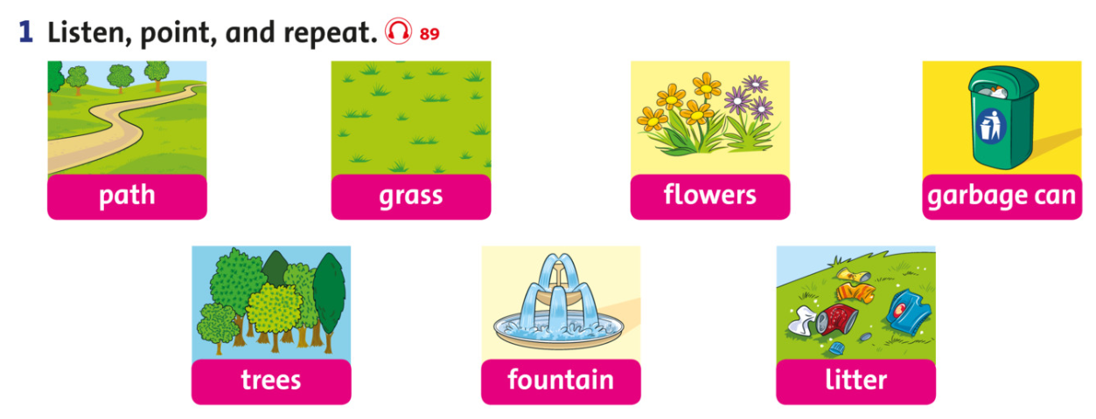

Slide 12
PAIR WORK
POINT AND SAY

Slide 13
WORD DUCKS
START

Slide 14
PARK
PATH
FOUNTAIN

Slide 15
GARBAGE CAN
TREES
FOUNTAIN

Slide 16
FOUNTAIN
PATH
GRASS

Slide 17
FLOWERS
LITTER
FLOWERS

Slide 18
FOUNTAIN
TREES
GRASS

Slide 19
TREES
LITTER
PATH

Slide 20
Well done!

Slide 21
Tasks: Watch the video and answer these questions
Where are they?
What are they doing?

Slide 23
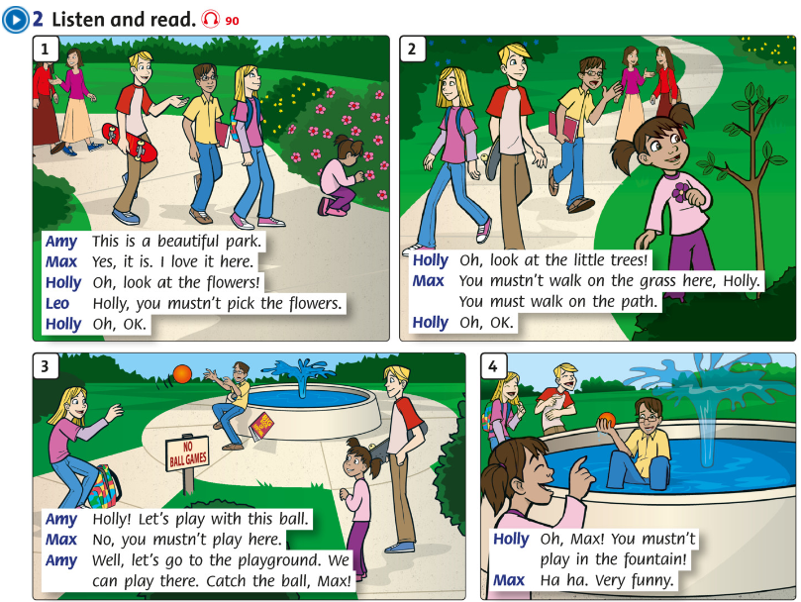

Slide 24
Workbook time!!!

