Slide 1
Unit starter:
Grade 4
Lesson One
This Photo by Unknown Author is licensed under CC BY-SA-NC

Slide 3
Monday, October 4th , 2021
Unit starter: Welcomback!
Lesson 1

Slide 4
Listen and sing

Slide 6
Tasks: Watch a video and answer these questions
1. Where are they? 2. How many people are there?

Slide 7
Story

Slide 8
Tasks: Work in pair and answer these questions
1. Where are they? 2. How many people are there?

Slide 9
Read again

Slide 10
Tasks: Work in groups
Roleplay

Slide 11
Tasks: Worktime!
Finish the works in your workbook!

Slide 12
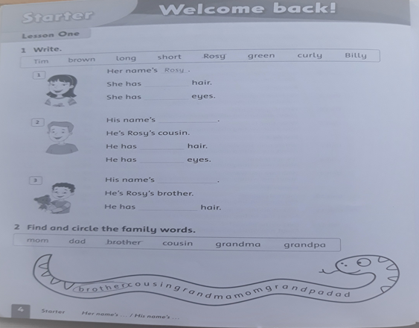

Slide 13
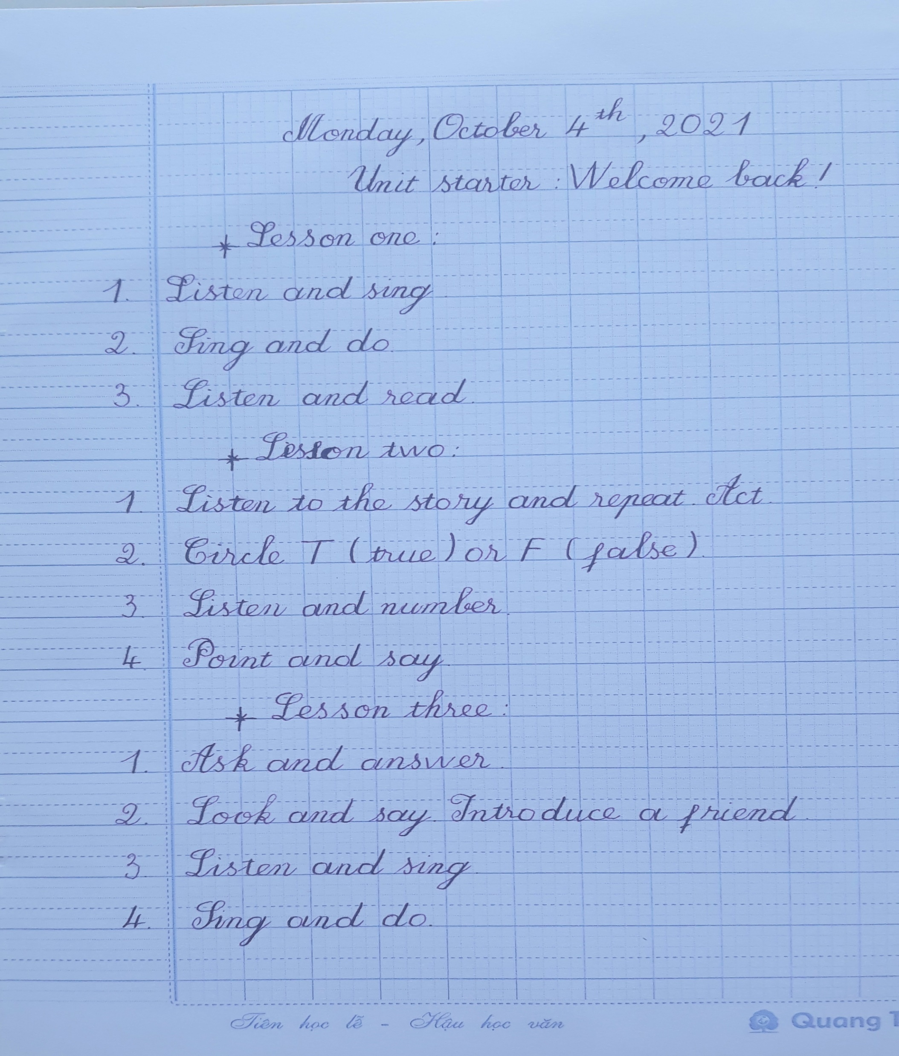
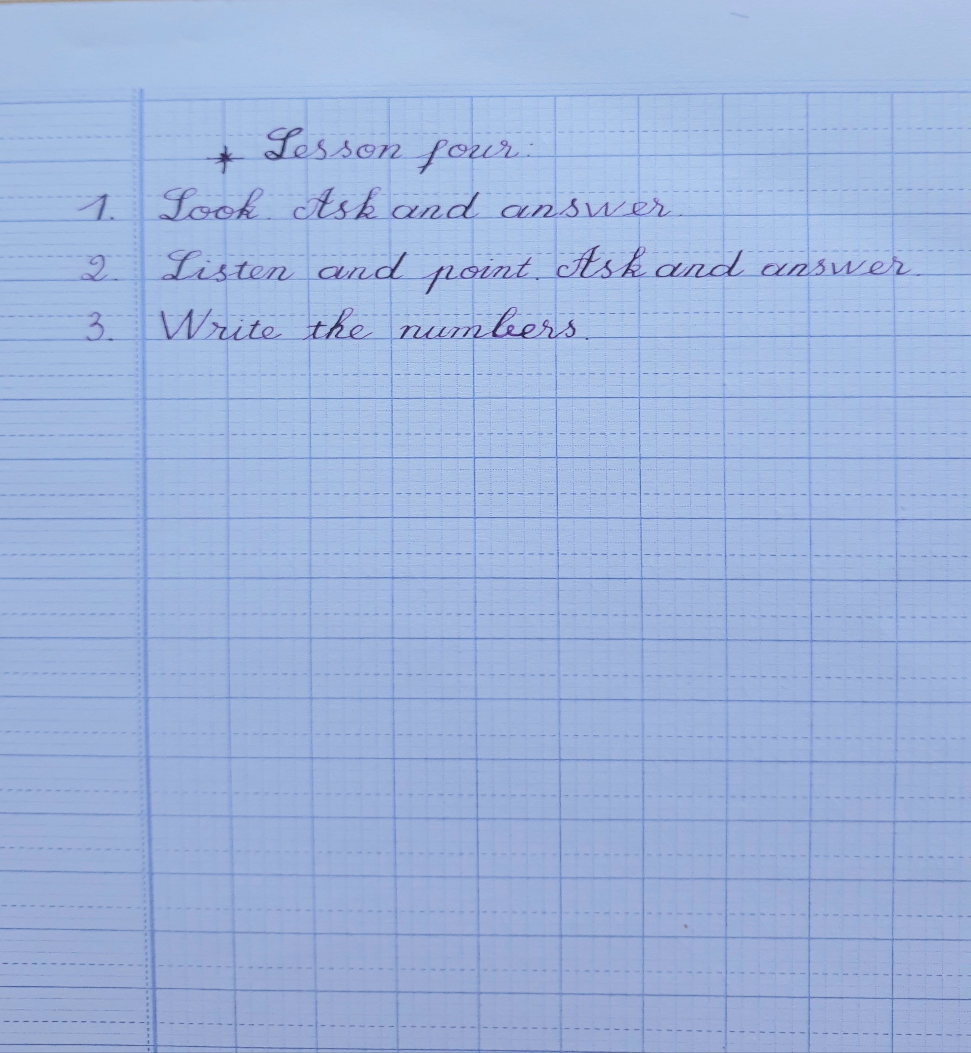

Slide 14
Tasks
1. Draw a picture of yourself. 2. Tell your friends about your picture.

Slide 15
Goodbye~!

