Slide 1
GRADE 3
Unit Starter
Hello!

Slide 2
Tuesday, October 5th , 2021
Unit starter: Hello!
Lesson 1+2

Slide 4
Listen and point

Slide 6
Pair work: Ask and answer

Slide 7
Listen and point

Slide 8
Game time

Slide 10
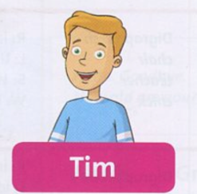
My hair is blond.
My T-shirt is blue.
My name starts with T.
Nothing here. ☹

Slide 11
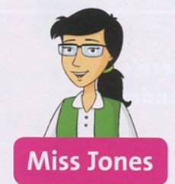
I am a teacher.
Nothing here. ☹
My hair color is black.
I wear glasses.

Slide 12
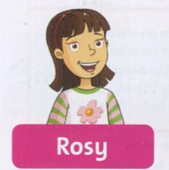
I am Tim’s friend.
My name starts with R.
My hair is quite short.
Nothing here. ☹

Slide 13
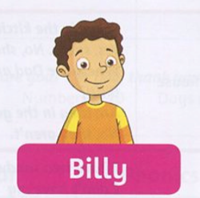
Nothing here. ☹
My hair is brown.
My T-shirt is orange.
I am very young.

Slide 14
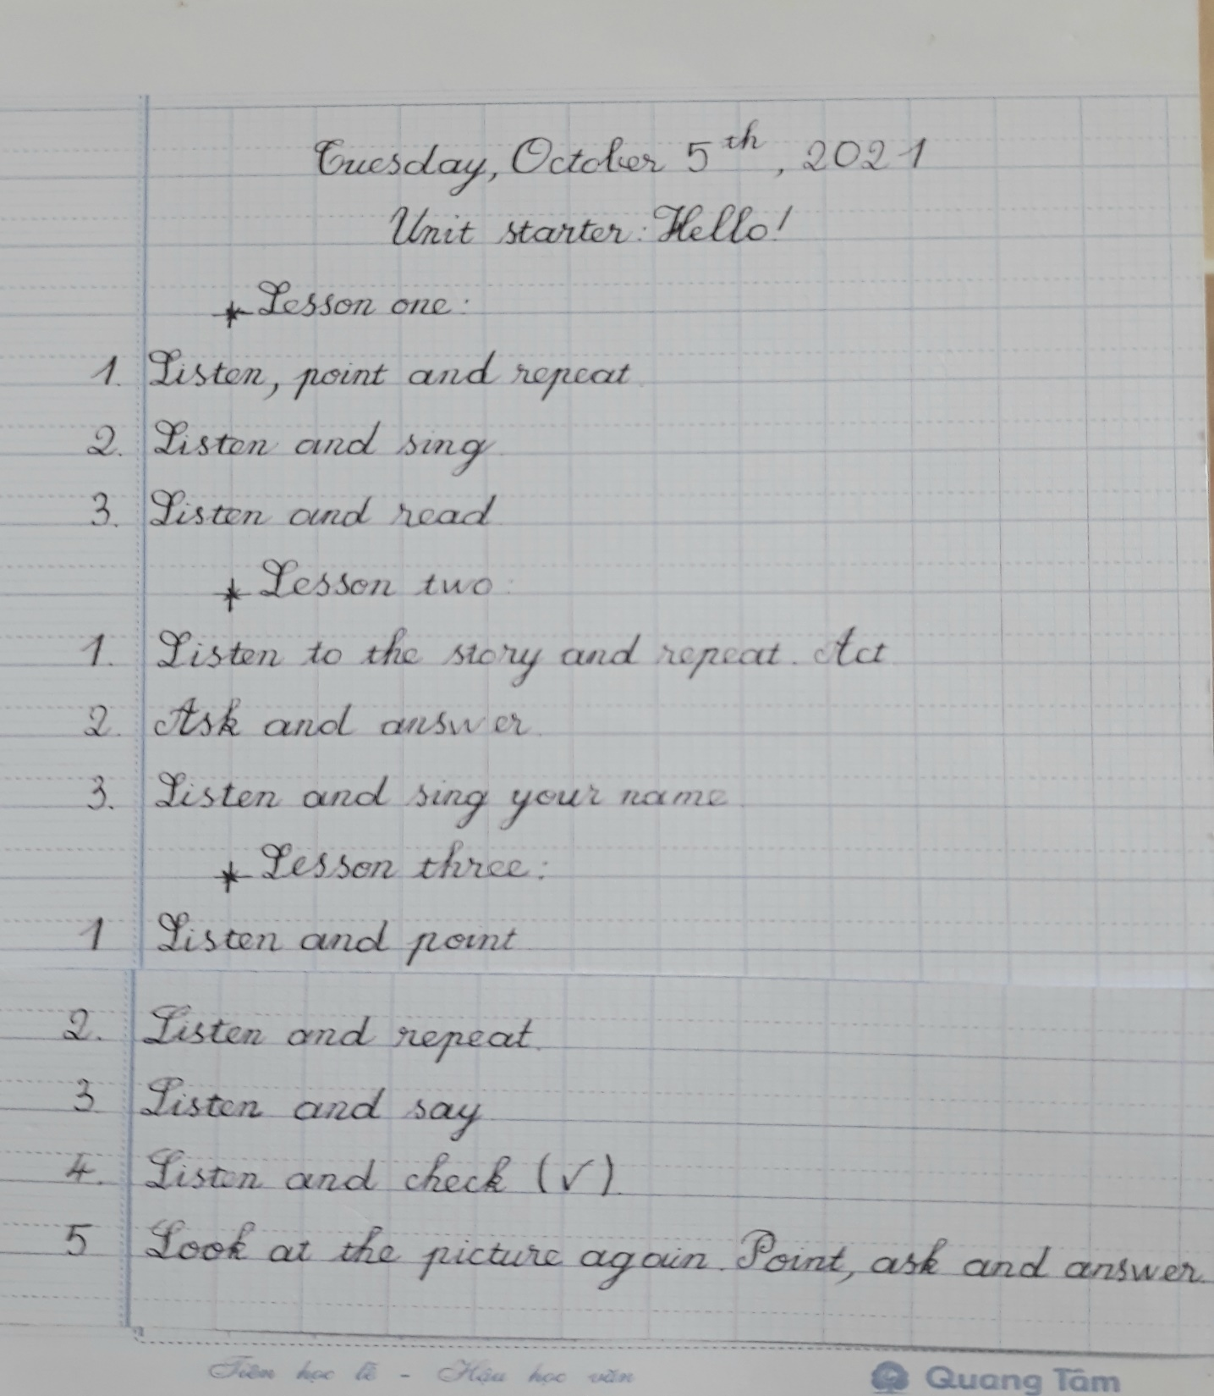
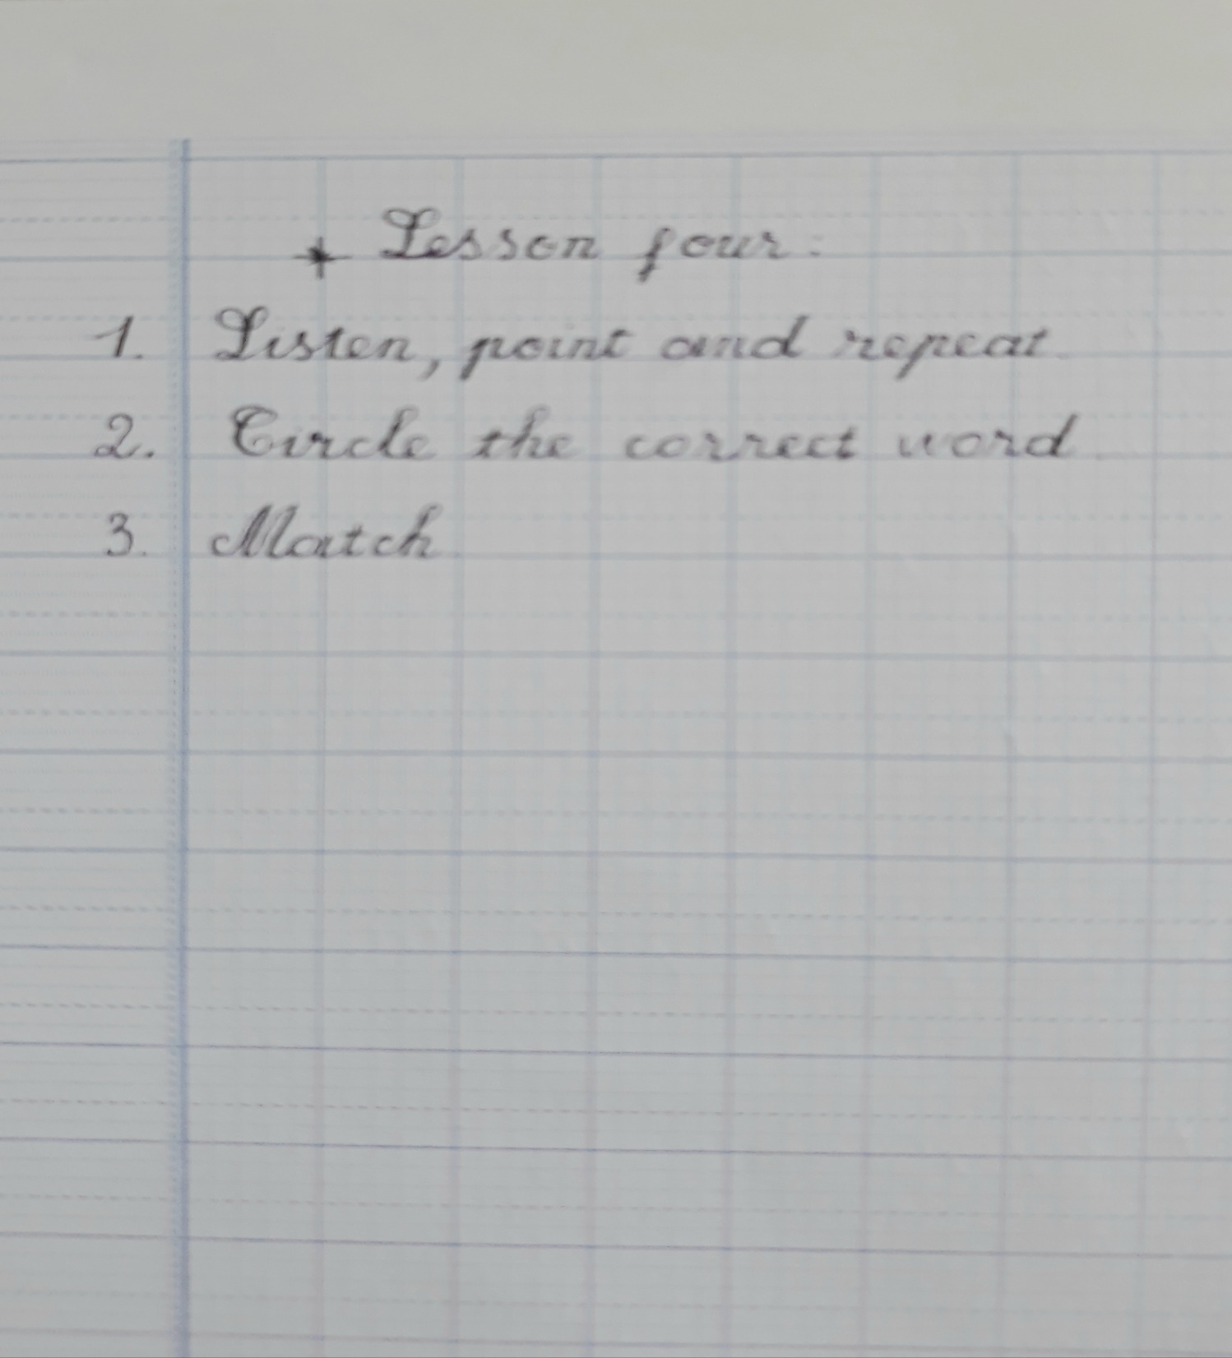

Slide 15
Workbook time

