Slide 1
Unit Starter My Family
GRADE 4
LESSON 3

Slide 3
Exercise:
were
1. The children ……….. hungry.
was
2. She …………. ten last year.
shorter than
3. She is ……….. ……………. (short) Lan.
younger than
4. My sister is ………... ................ (young) my mom.
smaller than
5. The monkey is ………….. ……….. (small) the cow.
bigger than
6. This book is ……….. …………. (big) that book.

Slide 4
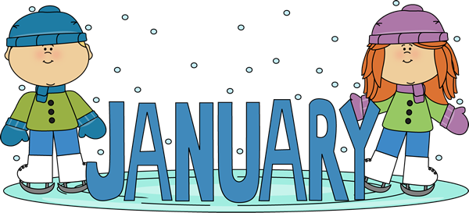
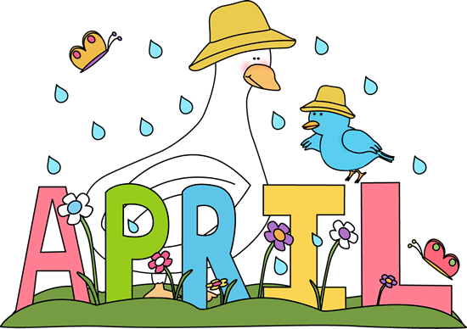
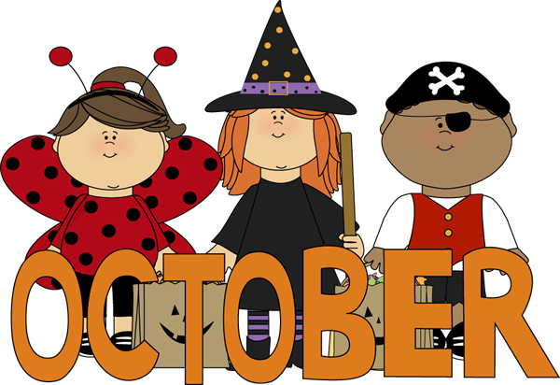
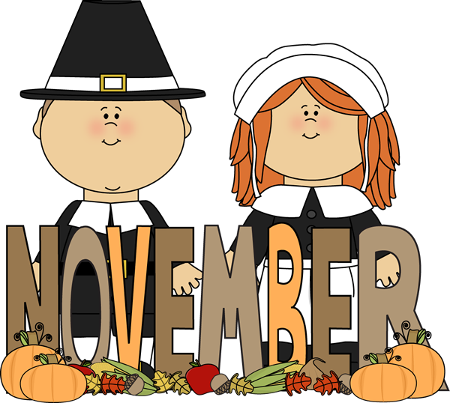
Lesson 3:
Months of the year

Slide 5
LISTEN and REPEAT

Slide 9
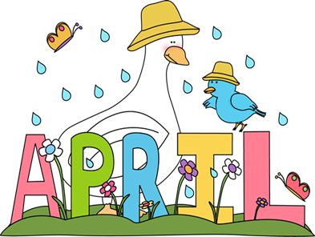

Slide 12
Friday, September 24th, 2021
Starter
Lesson 3: months of the year
January: tháng 1
February: tháng 2
March: tháng 3
April: tháng 4
May: tháng 5
June: tháng 6

Slide 16
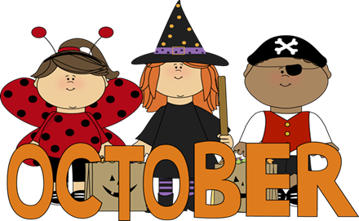

Slide 17
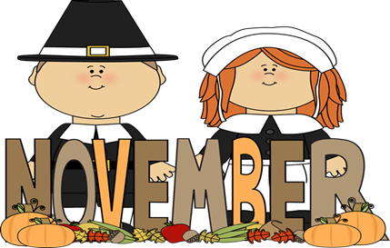

Slide 19
Tuesday, October 5th, 2021
Starter
Lesson 3: months of the year
July: tháng 7
August: tháng 8
September: tháng 9
October: tháng 10
November: tháng 11
December: tháng 12

Slide 20
Let’s play a game.

Slide 21
VOCABULARY
WATERFFALL
START

Slide 22
Halloween Day is in this month.
October
Yes, it’s October.
November
December

Slide 23
It is the first month of the year.
Yes, it’s January.
July
January
March

Slide 24
Teachers’ Day is in this month.
Yes, it’s November.
February
April
November

Slide 25
Children’s Day is on the first day of this month.
Yes, it’s June.
June
August
July

Slide 26
Children love this month because Christmas Day is in it.
Yes, it’s December.
January
February
December

Slide 27
Mother’s Day is on the second Sunday of this month.
Yes, it’s May.
August
May
July

Slide 28
Good job.

Slide 29
Listen and point

Slide 31
Listen and sing

Slide 33
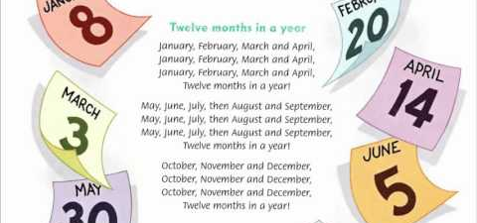
GROUPWORK: Sing and do

Slide 34
Tuesday, October 5th, 2021
Starter
Lesson 3: months of the year
July: tháng 7
August: tháng 8
September: tháng 9
October: tháng 10
November: tháng 11
December: tháng 12

Slide 35
Workbook time!!!

