Slide 1
GRADE 3
Unit Starter
Hello!
LESSON 3

Slide 2
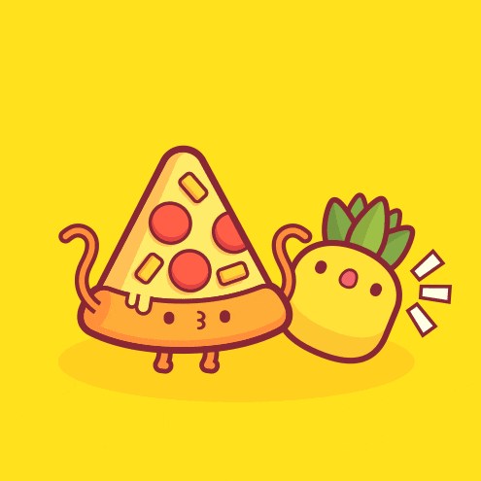
Review game

Slide 3
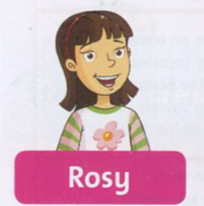

Slide 4
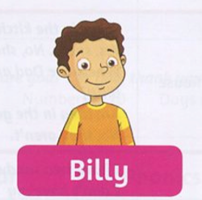

Slide 5
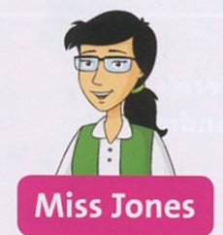

Slide 6
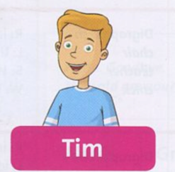

Slide 8
Listen and repeat

Slide 9
Wednesday, October 6th, 2021
Starter: Hello
Lesson 3: numbers
one: 1 - six: 6
two: 2 - seven: 7
three: 3 - eight: 8
four: 4 - nine: 9
five: 5 - ten: 10
How old are you? : bạn bao nhiêu tuổi?
I’m eight years old.

Slide 10
Game time

Slide 11
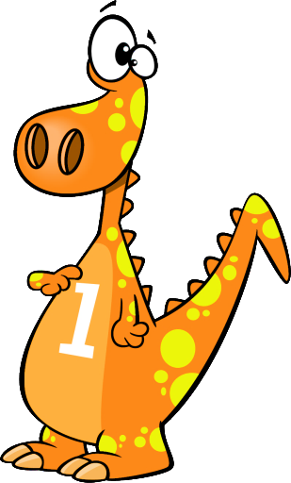
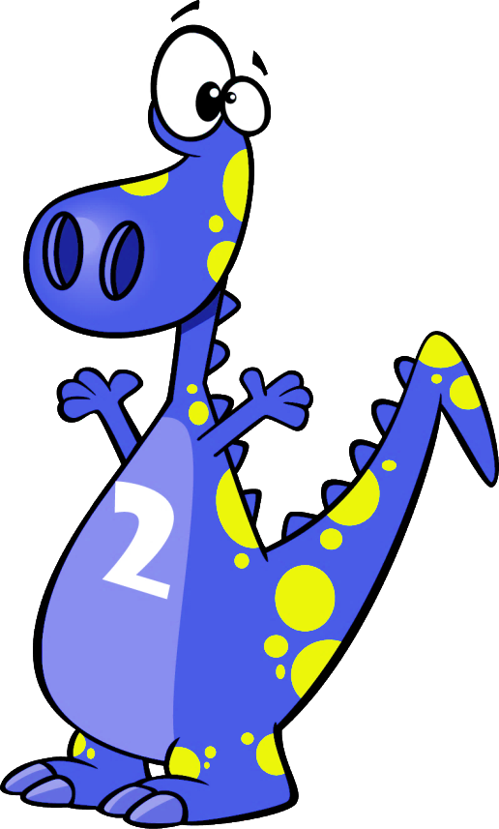
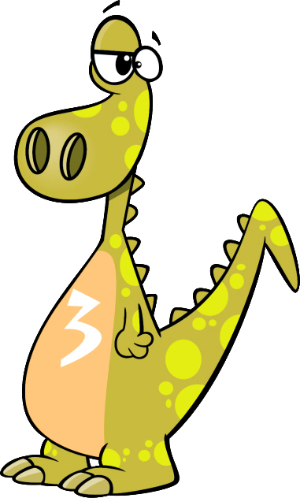

Slide 12
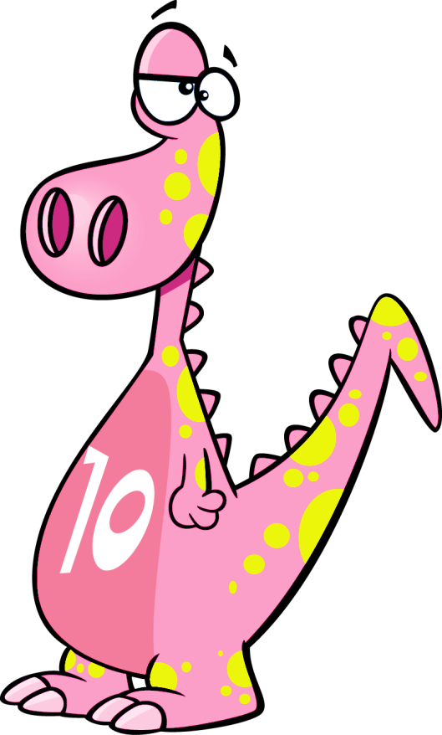
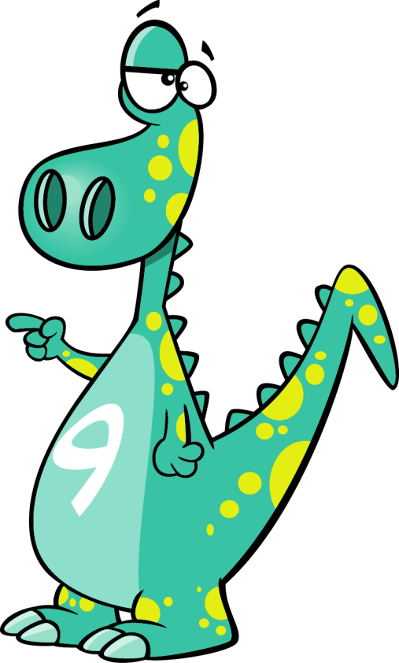
Click on the right dinosaur
nine
NEXT

Slide 13
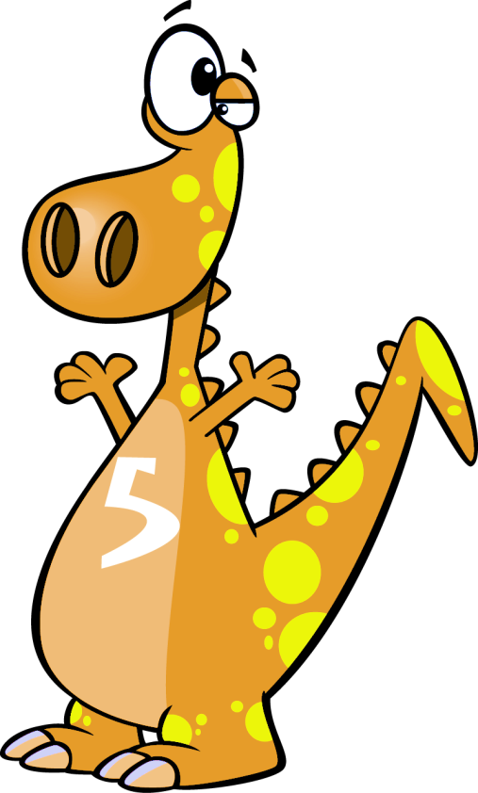
Click on the right dinosaur
five
NEXT

Slide 14
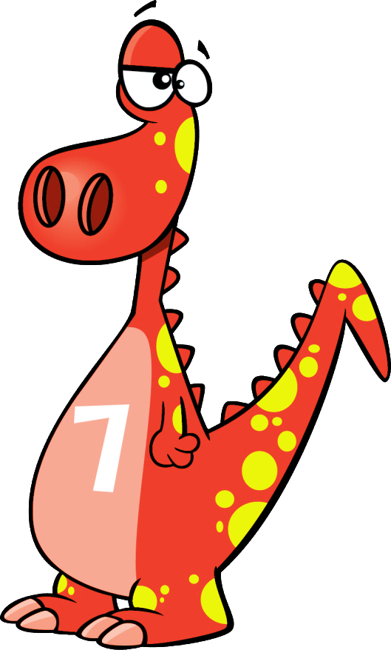
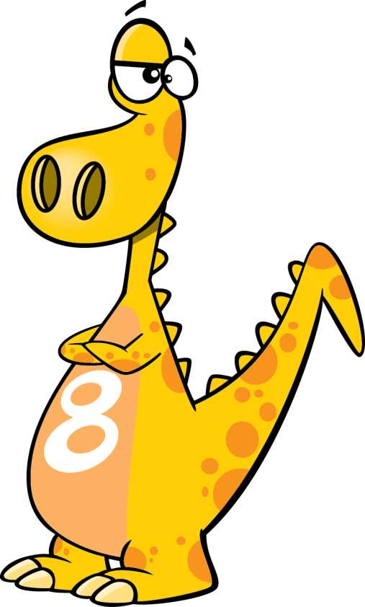
Click on the right dinosaur
eight
NEXT

Slide 15
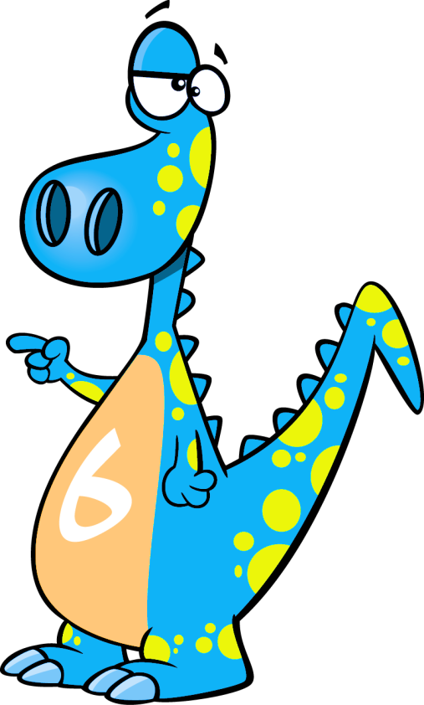
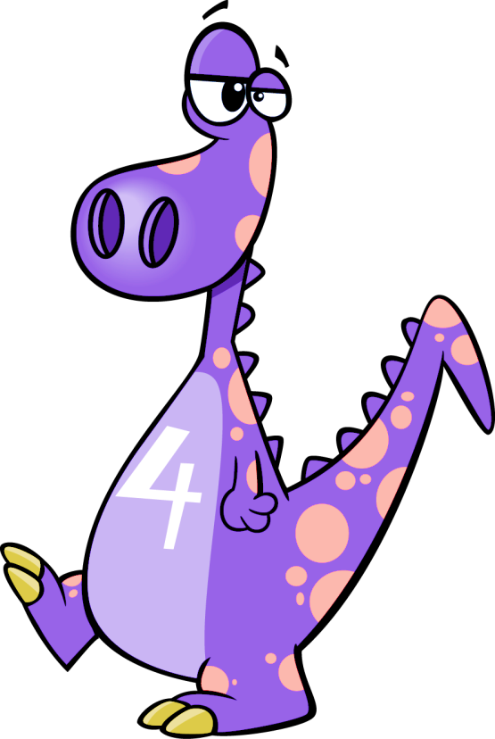
Click on the right dinosaur
six
NEXT

Slide 16
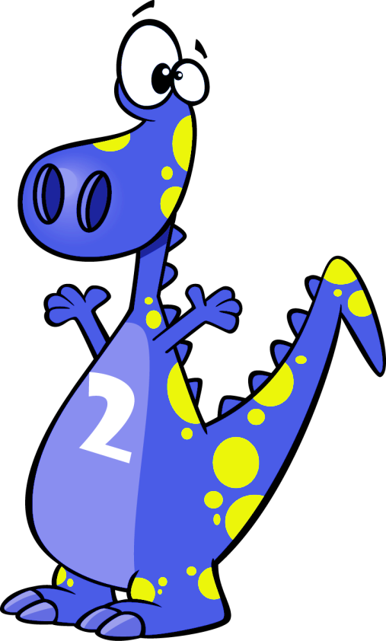
Click on the right dinosaur
two
NEXT

Slide 17
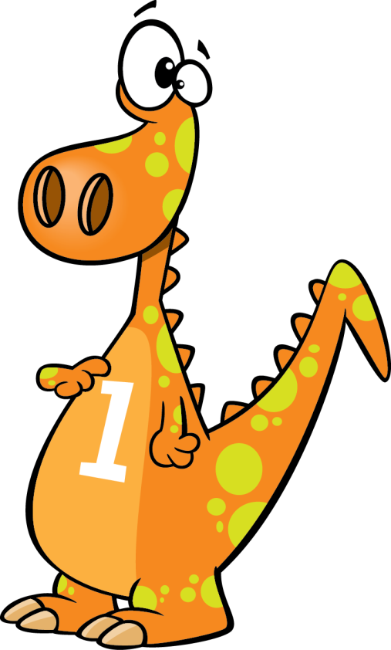
Click on the right dinosaur
one
NEXT

Slide 18
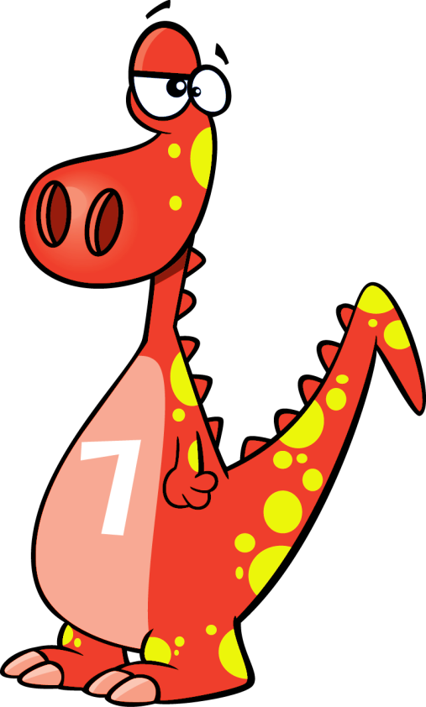
Click on the right dinosaur
seven
THE END

Slide 19
Listen and check
✓
✓
✓
✓

Slide 20
Wednesday, October 6th, 2021
Starter: Hello
Lesson 3: numbers
one: 1 - six: 6
two: 2 - seven: 7
three: 3 - eight: 8
four: 4 - nine: 9
five: 5 - ten: 10
How old are you? : bạn bao nhiêu tuổi?
I’m eight years old.

